Slide 1
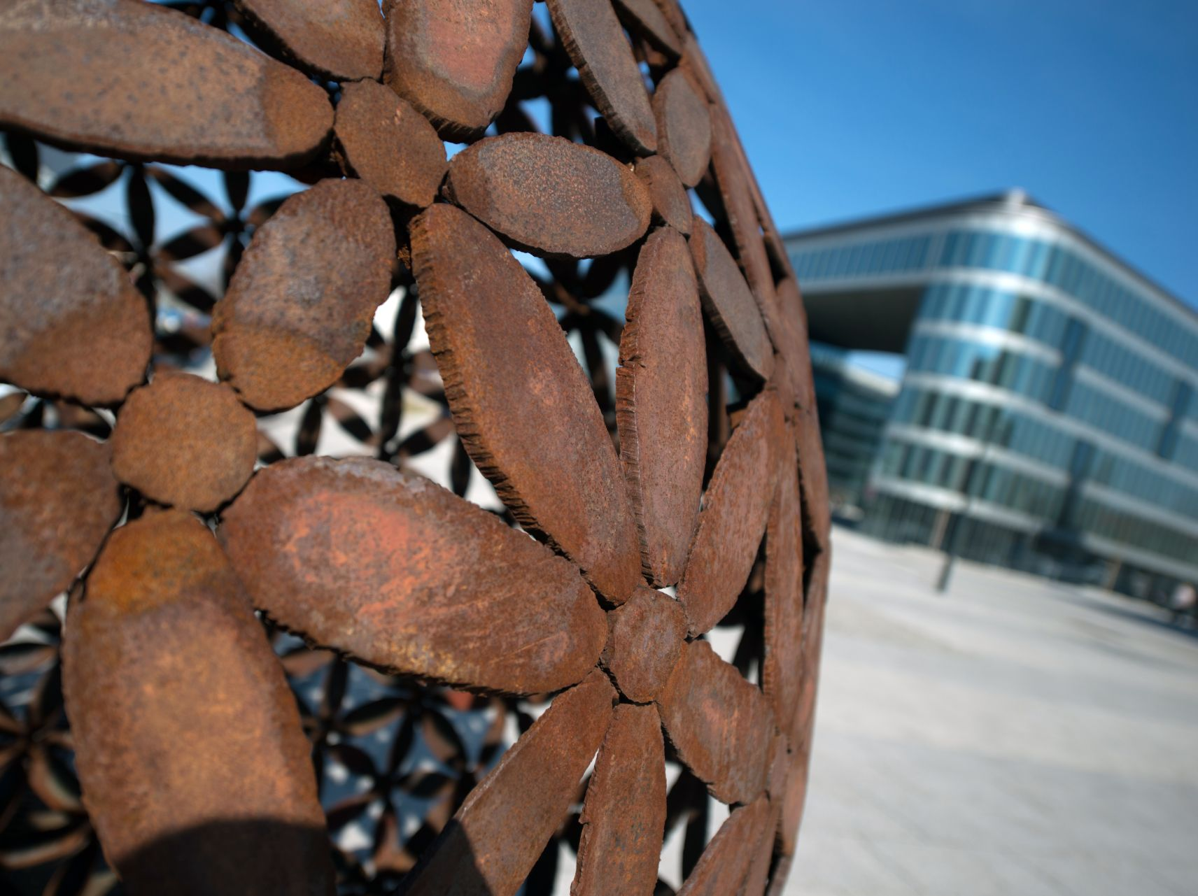

The Centre of the Fastest Growing Region of the Czech Republic
www.ostrava.cz

Slide 2
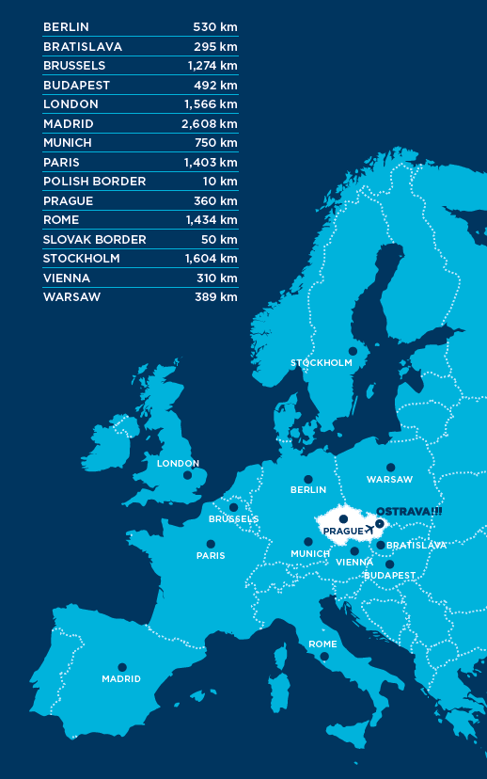
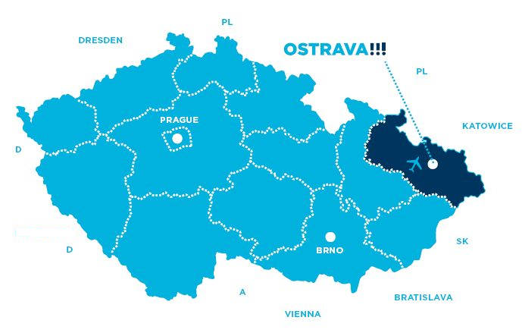

Location of the City
www.ostrava.cz

Slide 3
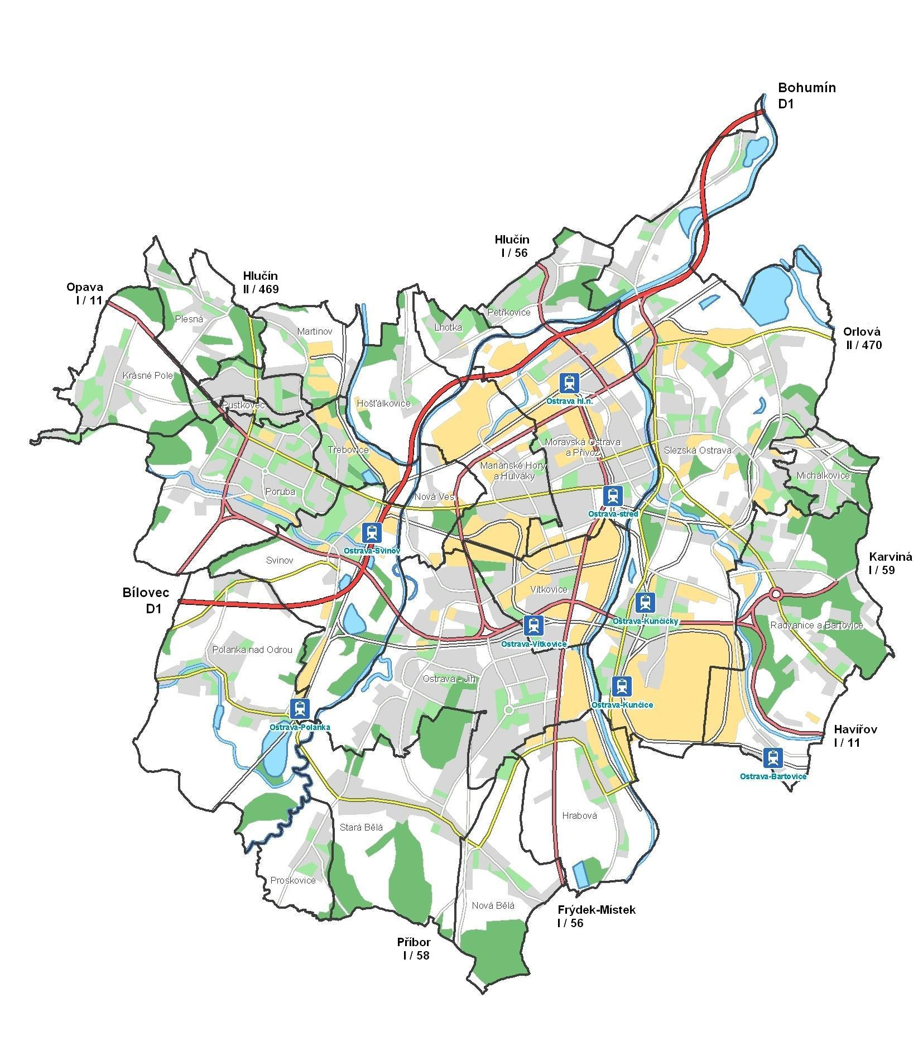
City Map
Poland
15 km
Prague
Slovakia
380 km
50 km
  Area: 214 km²
www.ostrava.cz

Slide 4
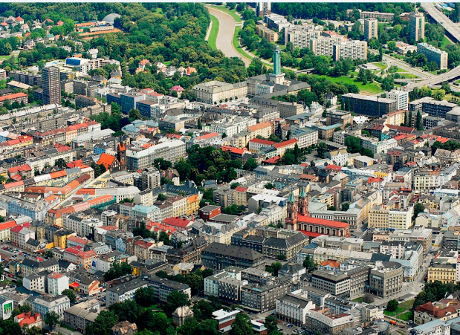
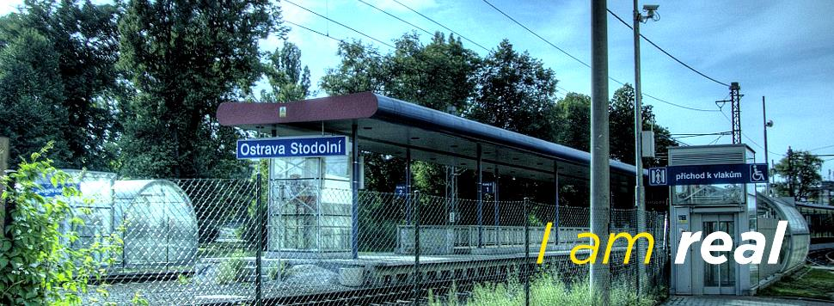
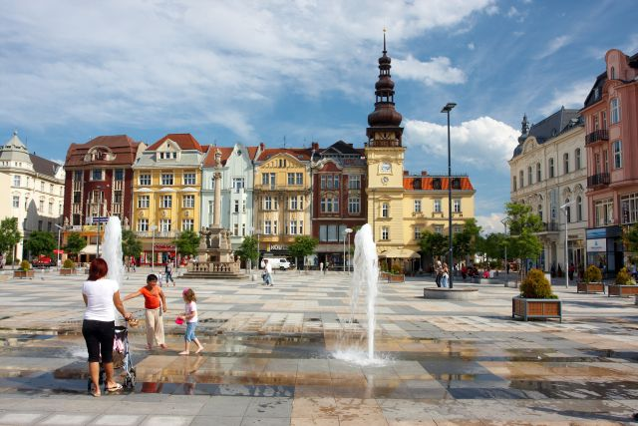
City of Ostrava
3rd largest city in the Czech Republic
Metropolis of the Moravian-Silesian Region
Area: 214 km²
299,483 inhabitants (1. 1. 2018)
Strategic location between Poland (15 km to the border) and Slovakia (50 km to the border)
International Airport 25 km from the city centre
D1 highway and railway corridor
www.ostrava.cz

Slide 5
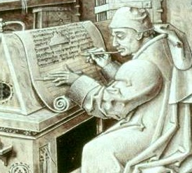
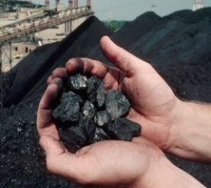
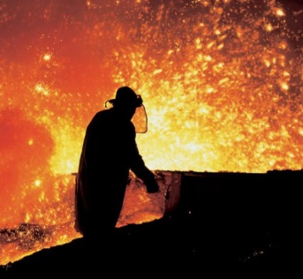
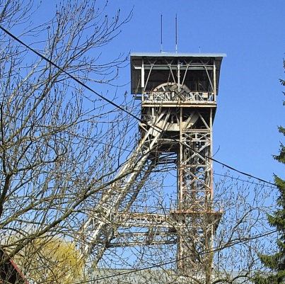
History
1267 The first written documentation about Ostrava
1763 The discovery of coal, resuscitating the economic life
1828 Establishment of an ironworks
1994 The end of coal mining in Ostrava
GUIDED BY TRADITION, LOOKING FOR THE FUTURE
Notes:
Local business structure has changed dramatically since the onset of freemarket economy some 20 years ago
Industrial production relying solely on heavy industries has been phased out
Ostrava and its surroundings have seen a tremendous economic boom with investment pouring into industrial parks, development projects and new hotels
Many leading-edge high-tech companies have established themselves in the region producing high-tech products
Foreign-owned companies with a local production base are developing research and development facilities locally
Ve třetím největším českém městě dlouhé roky zavírá provoz jeden průmyslový podnik za druhým. Naposledy to byla před půl rokem ocelárna Vítkovice Steel. Ostrava s 300 tisíci obyvatel se proto má časem proměnit z centra těžkého průmyslu na město moderních technologií

Slide 6
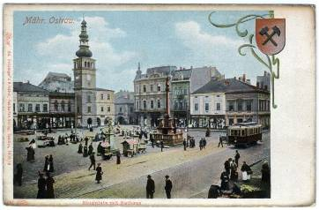
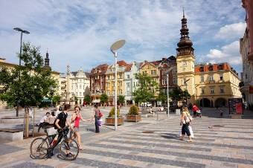
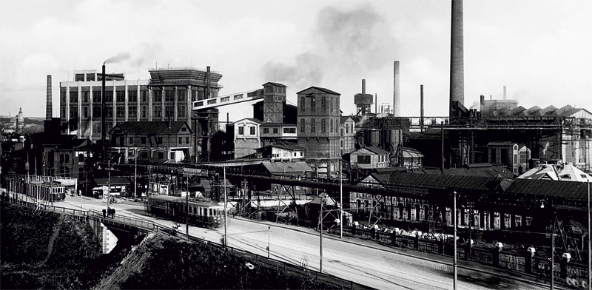
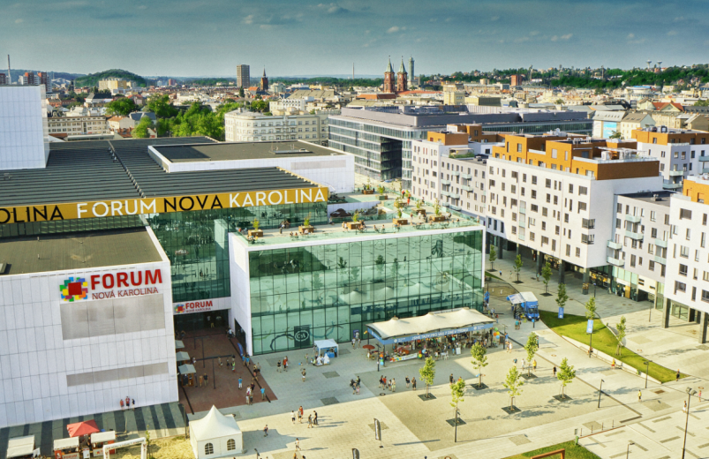
Ostrava changes
→
→
www.ostrava.cz

Slide 7

egc.ostrava.cz

Slide 8
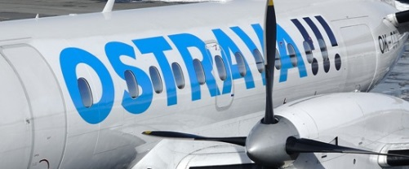
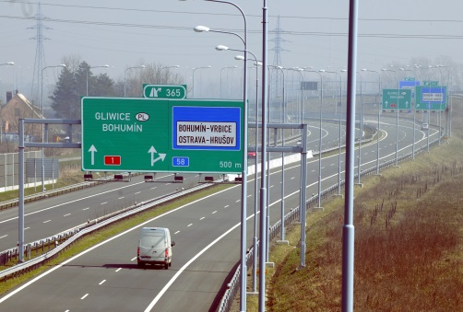
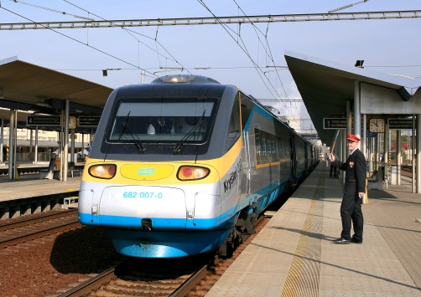
Transport
The Czech Republic’s north-eastern hub for transportation and logistics
Leoš Janáček Ostrava International Airport (25 km from the city centre)
  The largest regional airport in the Czech Republic
  The country´s second longest runway (3,500 x 63m)
  Regular travel links to Prague, London, Düsseldorf,
  Dubai, the plan: Helsinki, Amsterdam
The D1 highway
  part of TEN’s Multiple Mode Corridor No. VI,
  a north-south link from the Czech-Polish border, through Ostrava to the D1 highway to Brno
  the D1 highway is joined up with the Polish A1 motorway through Katowice – Gdaňsk and on to Helsinki
Important railway hub for both regional and international trains
  national Corridor II line (the basis of one of the most important north-south railway links in the EU)
www.ostrava.cz

Slide 9
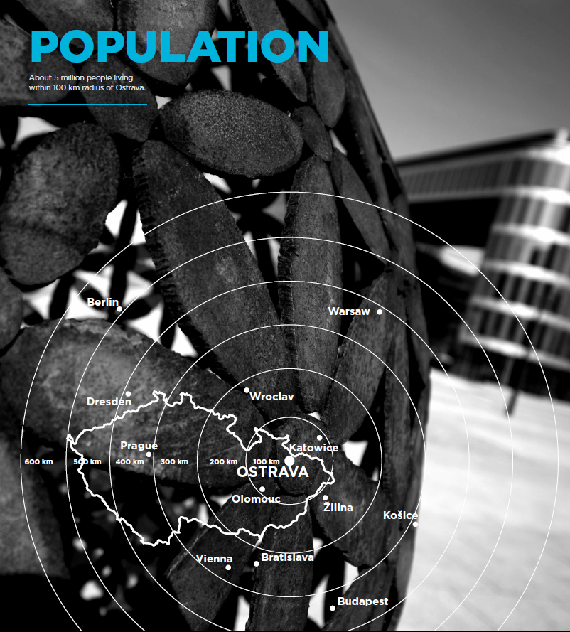
V okruhu 100 km od Ostravy žije 5 milionů lidí.
Around 5 million people living within 100 km radius of Ostrava.
www.ostrava.cz

Slide 10
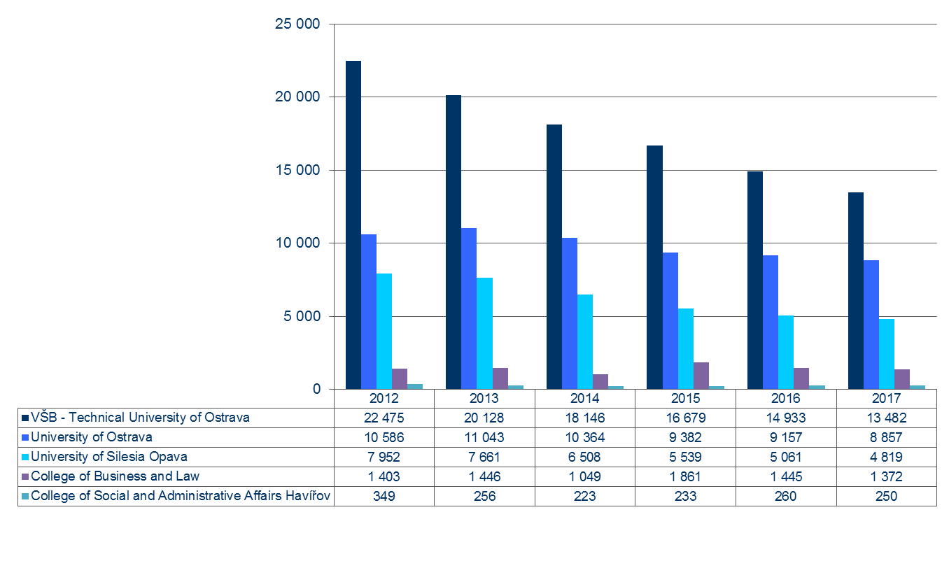
University student numbers - region
www.ostrava.cz

Slide 11
VŠB-Technical University of Ostrava
University of Ostrava
Source: Universities as of December 2017

Slide 12
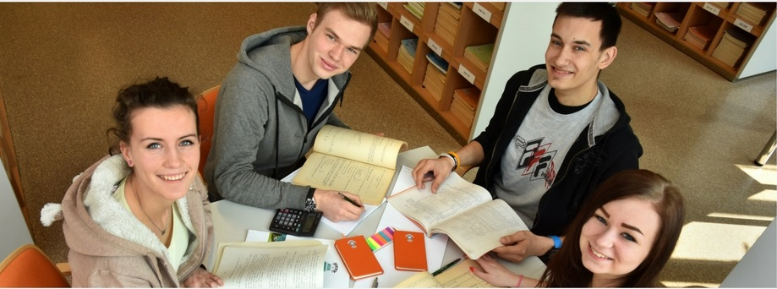
Secondary education – school leavers
Source: The Ministry of Education, Youth and Sports, 2018
8 schools with an international approach
www.ostrava.cz

Slide 13
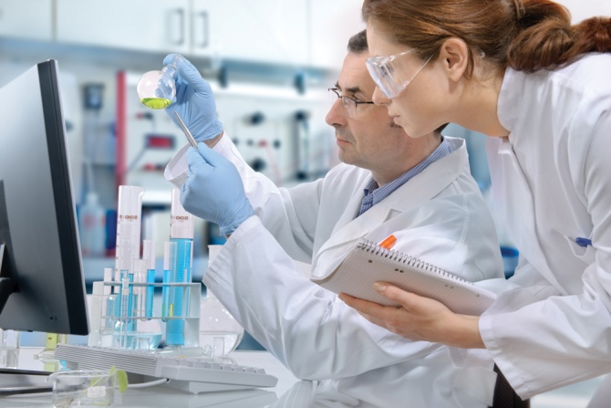
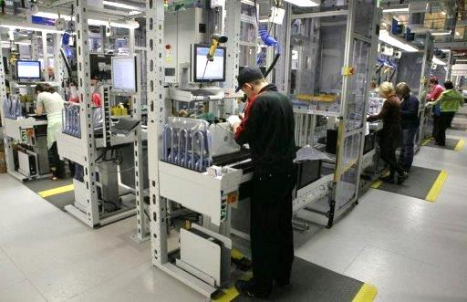

Work force
The Moravian-Silesian Region is the Czech Republic’s largest by population, with over 1.2 million inhabitants
Qualified, experienced and skilled work force (industrial history)
Rate of unemployment (III/2018)
  6.4 % in Ostrava
  5.4 % in Moravian-Silesian Region
  3.5 % in the Czech Republic
23,711 students at 3 universities in Ostrava
13,500 students at the Technical University Ostrava
Notes:
Prestižní britský žebříček Times Higher Education před pár dny znovu zveřejnil seznam 200 nejlepších univerzit v Evropě. Jako jediná z České republiky se na 170. místě objevila Vysoká škola báňská Technická univerzita Ostrava. Technická univerzita Ostrava se už podruhé umístila nejlépe ze všech českých univerzit v prestižním světovém žebříčku Times Higher Education.

Slide 14
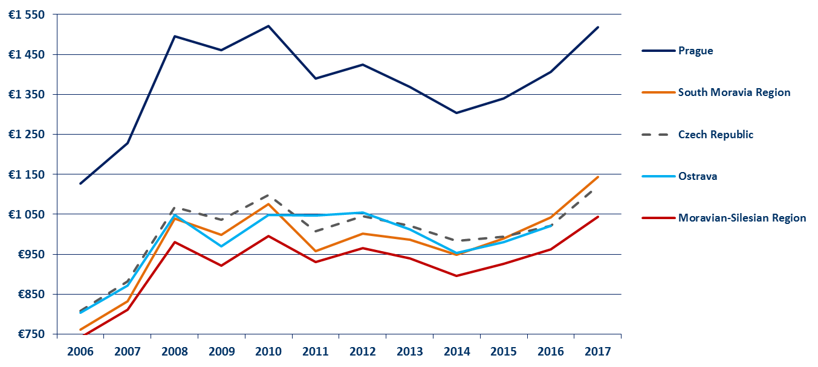
Workforce costs
Minimum wage
in the Czech Republic in 2018:
for a 40-hour week = CZK 12,200 per month = EUR 479.40
Basic rate per hour: CZK 73,20 = EUR 2.88
(1 EUR = 25.45 CZK as average e.r. January 2018)
Source: Trexima Ltd., Ministry of labour and social affairs
www.ostrava.cz

Slide 15
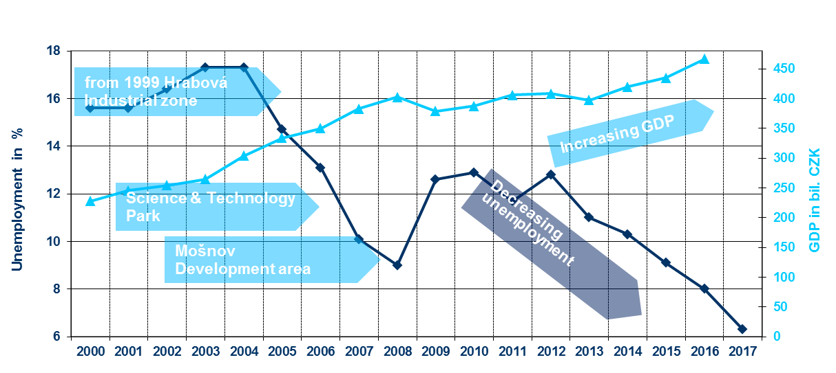
Unemployment and GDP in Moravian-Silesian Region
31.12.2017
www.ostrava.cz
Notes:
Zdroje dat: ČSÚ, Úřad práce v Ostravě, Patria.cz

Slide 16
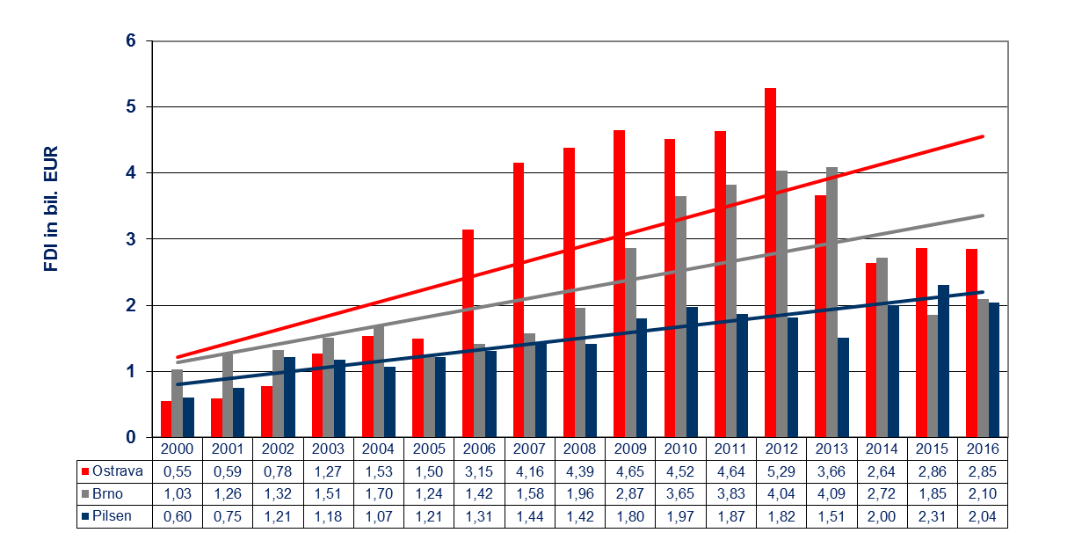
Foreign direct investments in bil. EUR (cumulative)
Dates as of 31 December, absolute values.
Source: Czech National Bank 2018
www.ostrava.cz

Slide 17
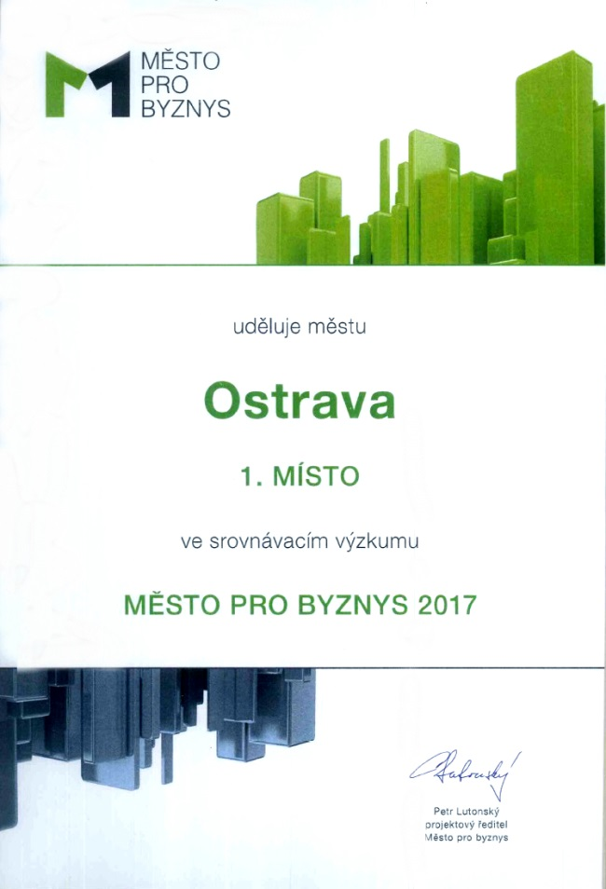
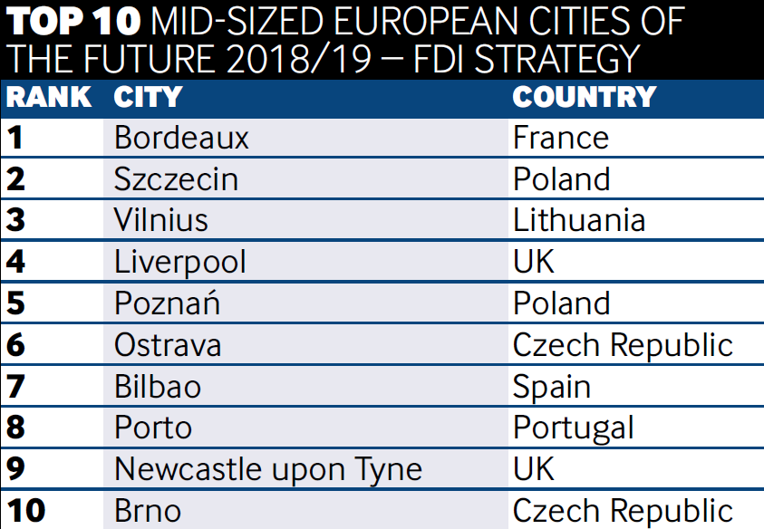
Ostrava ranks among the TOP 10 most attractive cities in Europe for investment
1st place „City of Business in the Czech Republic - 2017“
Excellent result in the prestigious British fDi Magazine survey (part of the Financial Times Group):
European Cities and Regions of the Future 2016/2017 and 2018/2019
Ostrava is the ideal strategic location helping you to grow your business.
www.ostrava.cz

Slide 18
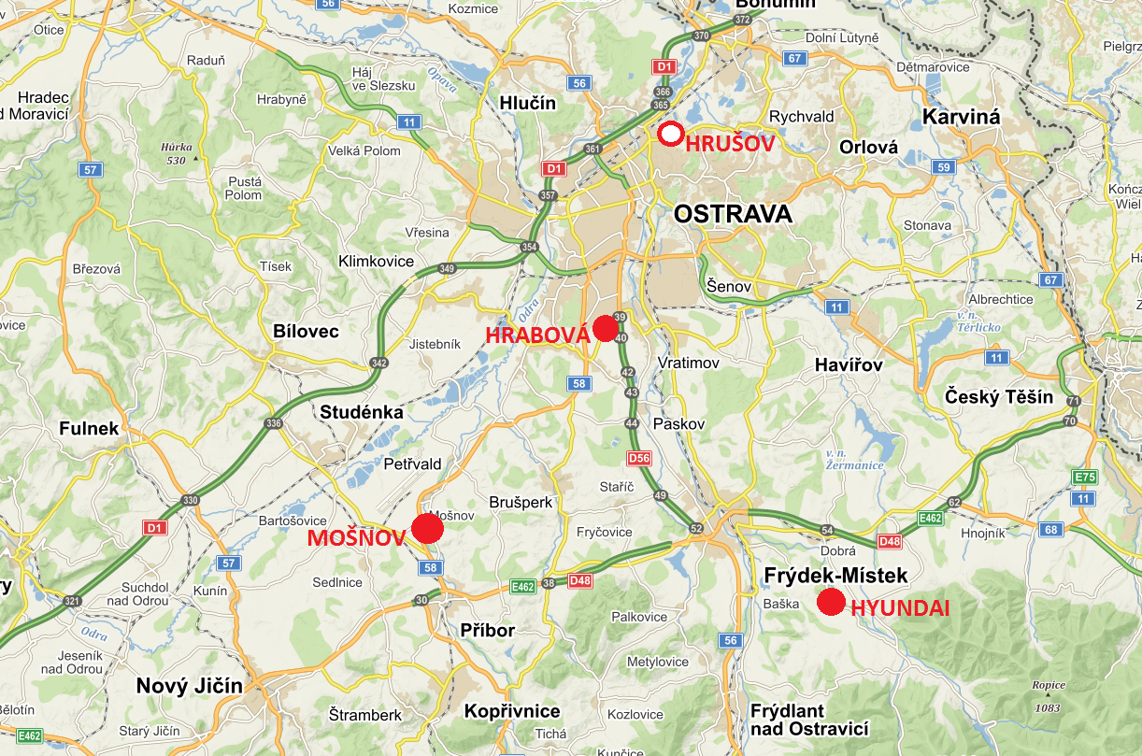
Industrial Zones

Slide 19
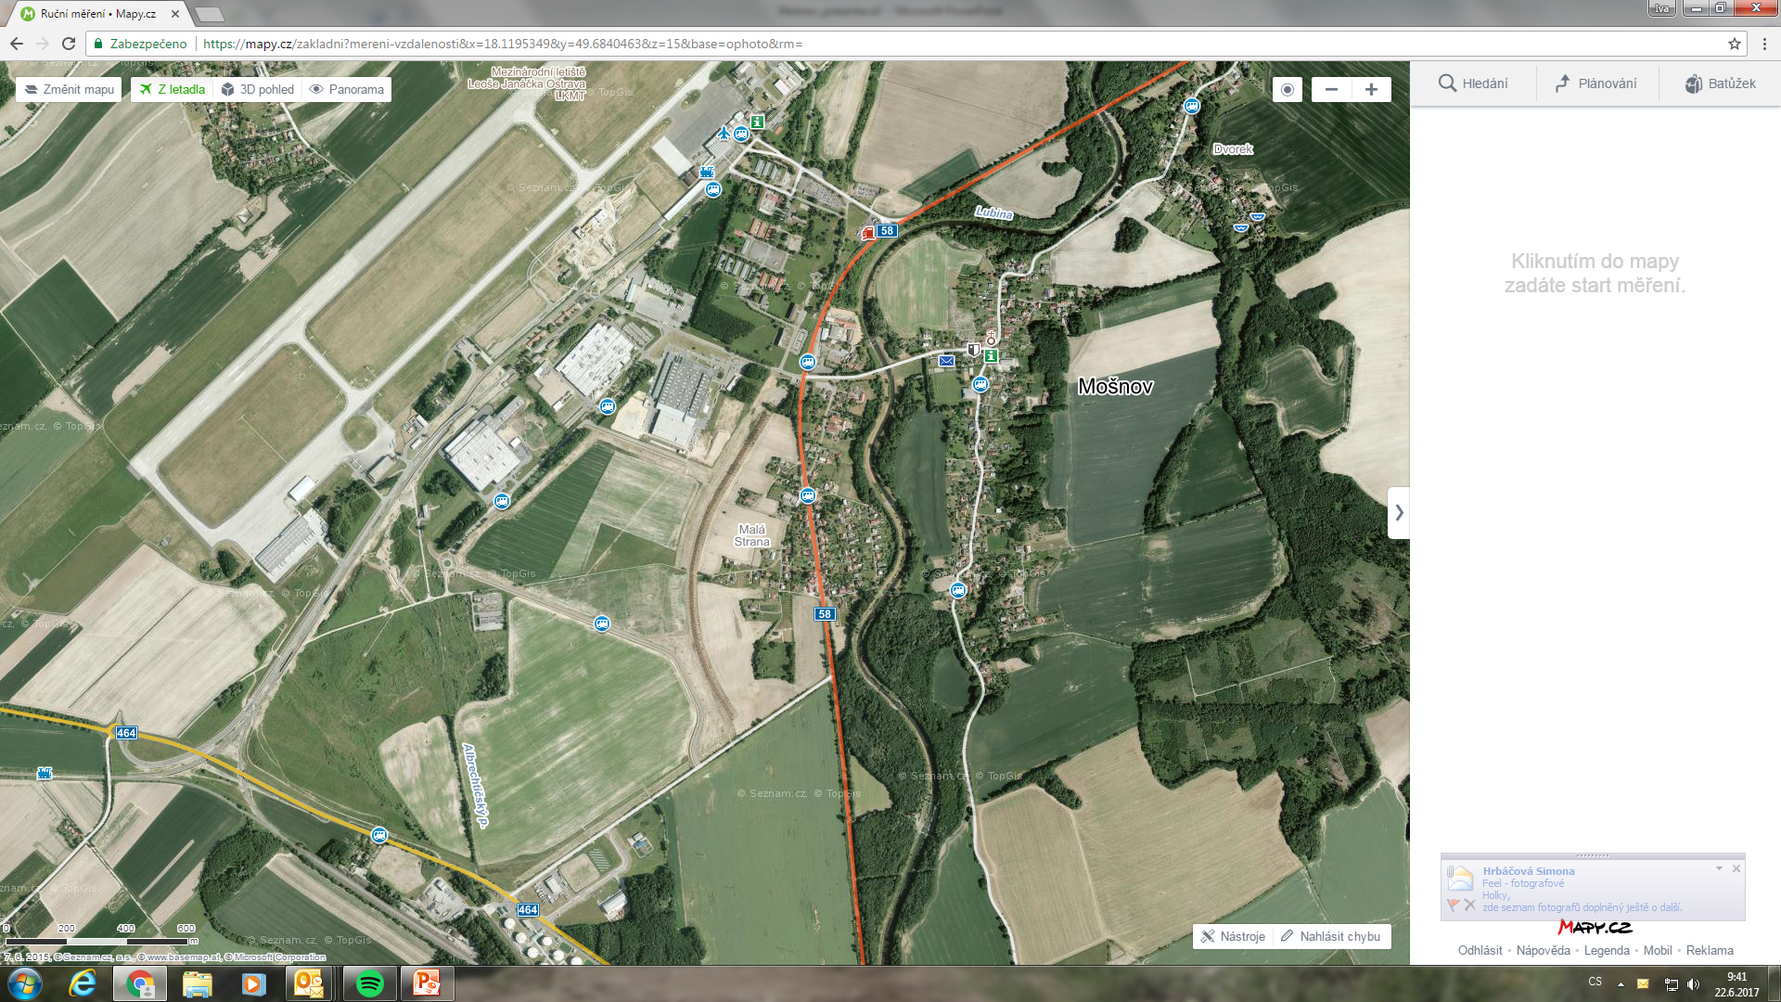
Industrial Zones
Mošnov
Strategic Industrial Zone: 200 ha
Multi-modal Logistics Centre: 80 ha
Small Development zone: 32 ha
Small and Medium sized
Enterprises (SMEs): 10 ha
Administrative Centre LJ: 20 ha
2004 - The original 30 ha zone is expanded to 130 ha
November 2005: Government resolution no. 1471 – the zone gains ‘strategic’ status and is further expanded to 200 h
Companies have invested CZK 12.123 billion to date
3,428 jobs created (as of December 2017)
Total cost: 2,197 billion CZK (State: 787 million, City of Ostrava: 267,1 million, others – especially ČEZ Distribuce, Moravian-Silesian Region and other investors: 1,143 million CZK)
Area for sale to investors is currently 58 ha + 32 ha in Small Development zone
www.ostrava.cz

Slide 20
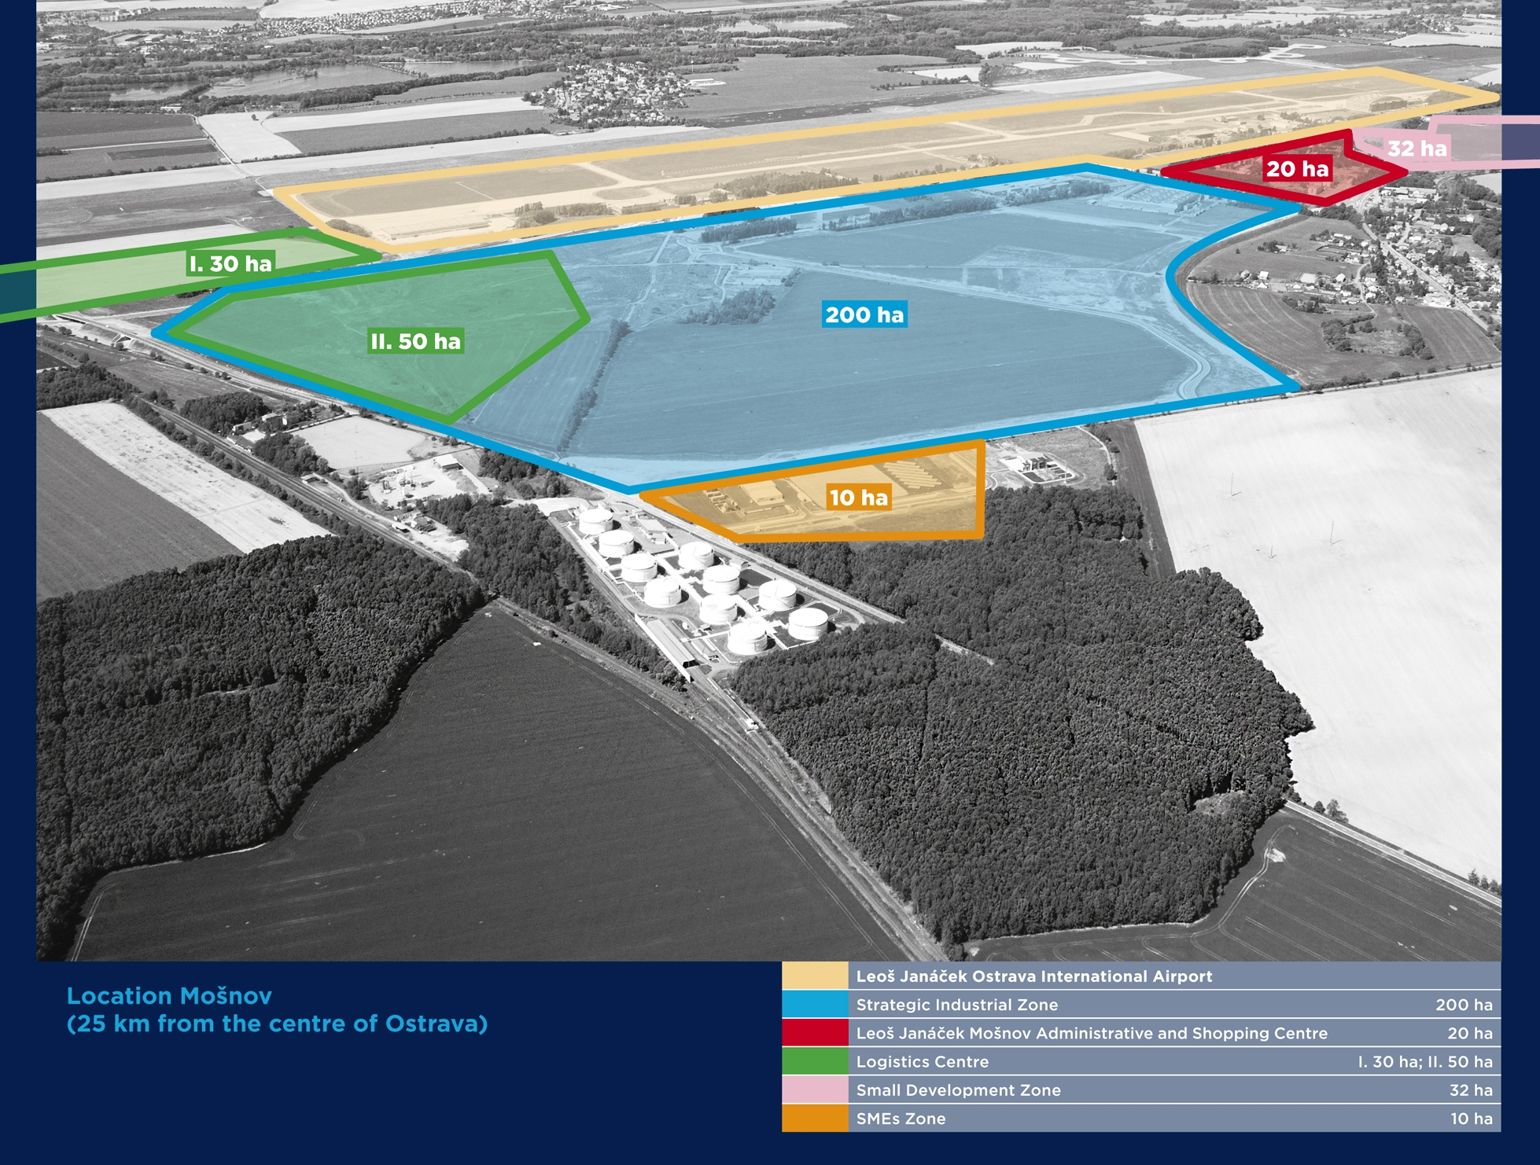

Slide 21
Investors in the Zone Mošnov – overview
 | Investment by companies (millions of CZK) | Number of jobs – December 2017 | Number of jobs – December 2018 (assumption)
MAHLE Behr Ostrava, s.r.o. | 3,001 | 1,538 | 1,595
PLAKOR CZECH, s.r.o. | 3,256 | 1,088 | 1,199
CROMODORA WHEELS, s.r.o. | 2,470 | 404 | 465
ENES Cargo | 25.04 | 9 | 9
Ostrava Airport Multimodal Park, s.r.o. | 48 | 0 | 50
Mobis Automotive System Czech s.r.o. | 3,288 | 385 | 790
Vítkovice-výzkum a vývoj-techn. aplikace a.s. | 35.00 | 4 | 10
Total | 12 123.04 | 3,428 | 4,118
www.ostrava.cz

Slide 22
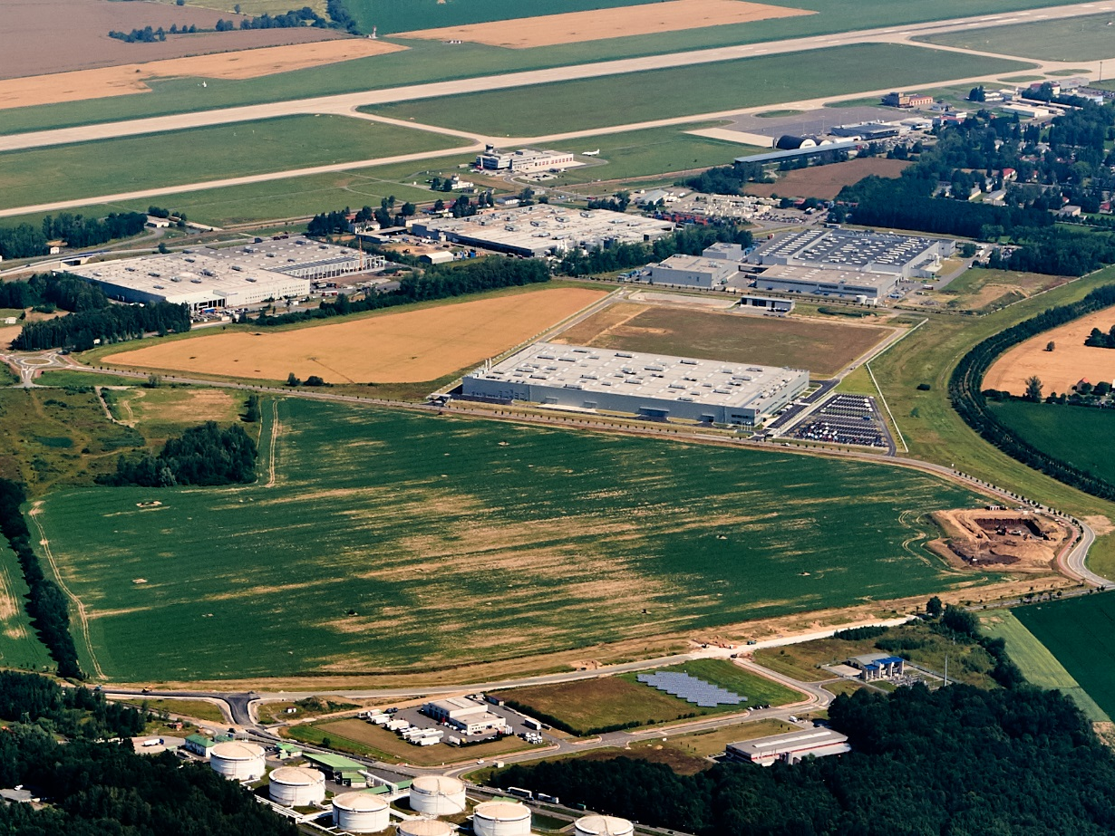




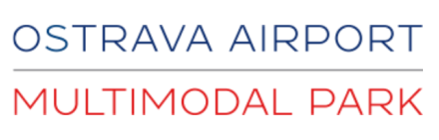

Slide 23
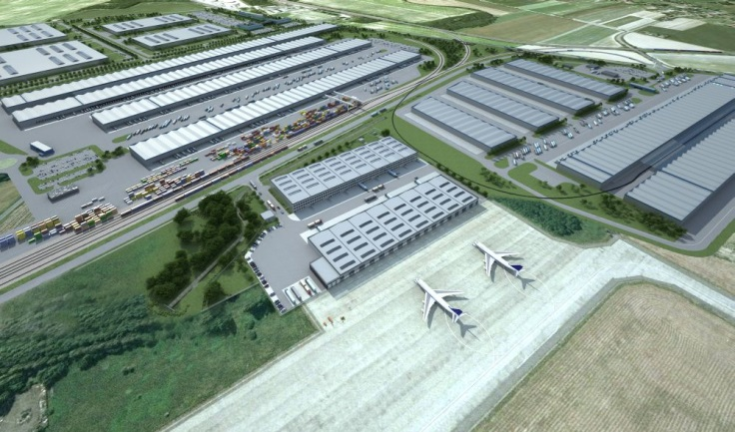
Multimodal logistics centre in the zone Mošnov
Logistics centre including container terminal – combination of road, rail
and air freight on one site – unique project within the Czech Republic
Developed in cooperation with the City of Ostrava and the Moravian-Silesian Region
Location: Ostrava- Mošnov Strategic Industrial Zone, 25 km from central
Ostrava, adjacent to Leoš Janáček Ostrava International Airport
Work begins: 4Q/2010
Completion of all phases: 2015 - 2023
Cost: CZK 4 billion
Total area: 80 ha
Phase 1: air freight centre - completed / leased
Phase 2: rail freight centre - work started 1/2018
Phase 3: multimodal cargo under preparation
www.ostrava.cz

Slide 24
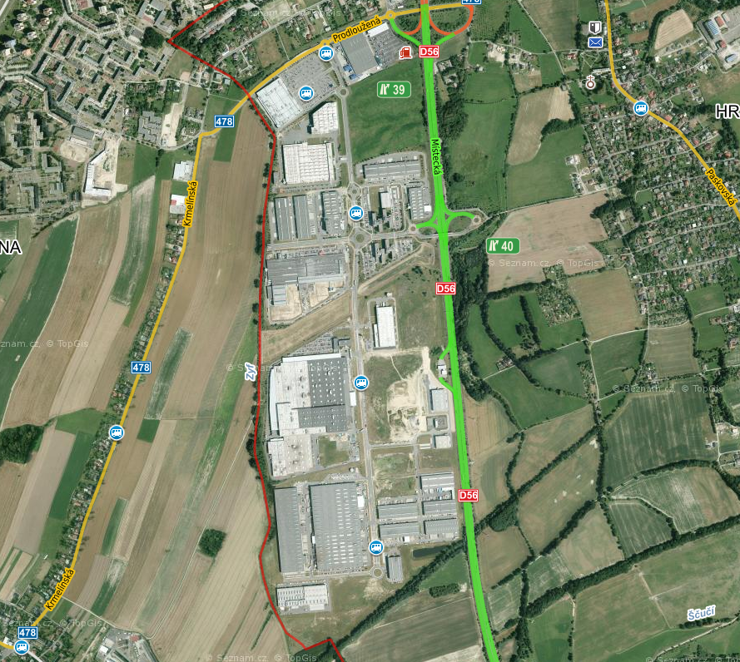
Industrial Zones
15 ha
Hrabová
Industrial Zone: 115 ha
Commercial Zone: 15 ha
115 ha
Planning began in 1999 and continued in 2000-2007
The City originally prepared a site of 30+30 ha.
CTP Invest expanded the zone (total area now 115 ha)
Costs of planning, land purchase and infrastructure construction were mainly covered by the City of Ostrava (total costs approx. CZK 691 million, of which City funding = CZK 573 million)
Currently over 50 companies operate in the zone
Total investments in the zone have exceeded CZK 17.14 billion (as of December 2017)
8,149 new jobs created (as of December 2017)
The zone won the Ministry of Industry and Trade Award for Industrial Real Estate of the Year for 2004, 2005, 2007, 2009 and 2010 (1st and 2nd place for the City of Ostrava, twice 1st place for CTPark and 1st place for Brembo as an investor of the year 2010)
www.ostrava.cz

Slide 25
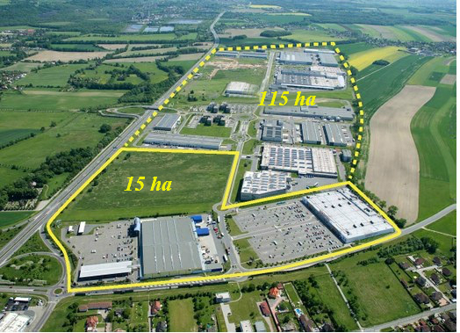
Hrabová Industrial Zone
Notes:
25

Slide 26
Investors in the Zone Hrabová– overview
 | Investment (millions of CZK) | Number of jobs – December 2017 | Number of jobs – December 2018 (assumption)
PEGATRON CZECH (formely ASUS Czech) | 1,117 | 1,022 | 1,700
SungWoo Hitech | 9,723 | 1,527 | 1,490
CTP Invest | 6,300 | 5,600 | 6,200
TOTAL | 17,140 | 8,149 | 9,440
www.ostrava.cz

Slide 27
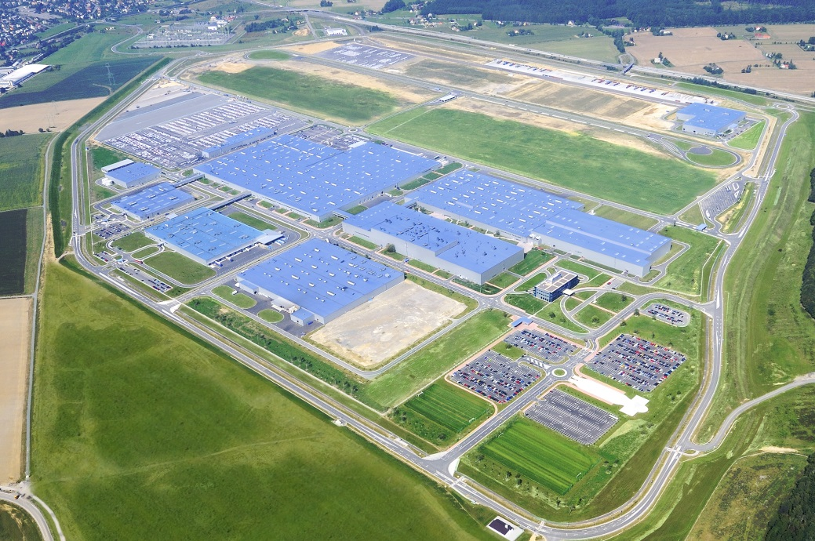

Strategic investor in the Region
Hyundai Nošovice
- 30 km from Ostrava
Industrial zone: 200 ha
Total investment: 1.12 billion EUR
Strategic investor: Hyundai Motor Manufacturing Czech
Established: 7. 7. 2006
The Hyundai investment is the largest industrial investment in the Moravian-Silesian Region since 1989, both in financial terms and in terms of new jobs created → major boost to the Region’s economic development.
Production capacity: 356,700 vehicles in 2017
Number of employees: 3,300 (2017)
www.ostrava.cz

Slide 28
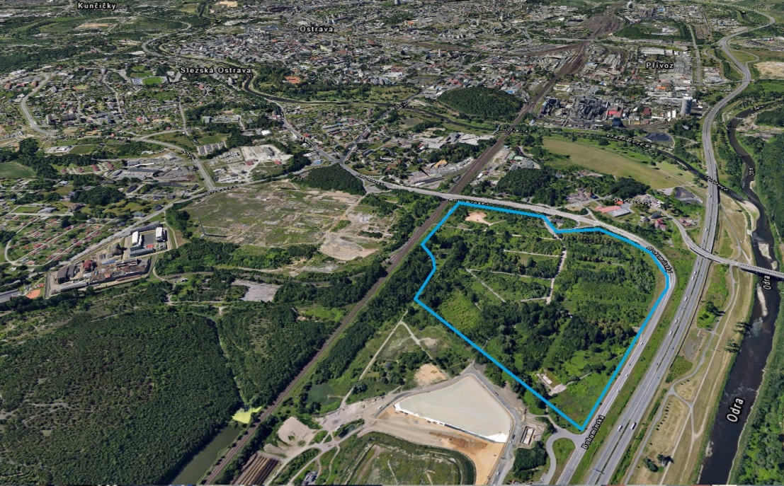
Hrušov Development Area
Brownfield
Size - about 34.7 ha
Former settlement for workers
„Social Brownfield“
Non-outflow basin
Proximity of highway D1
Mining influence
No ecological damage
Hrušov represents a very important location, particularly suitable for small and medium-sized companies. Among the advantages of the Hrušov zone is an ideal transport connection, immediate vicinity to the D1 motorway and a railway line.
The project envisages in particular the construction of rental office buildings or research and semi-production operations, leading to the creation of a minimum of 1,500 to 2,000 new jobs.
Currently, a call for tender for the implementation of an investment project in the Hrušov development zone was published - more information and challenges are available on https://hrusov.ostrava.cz

Slide 29
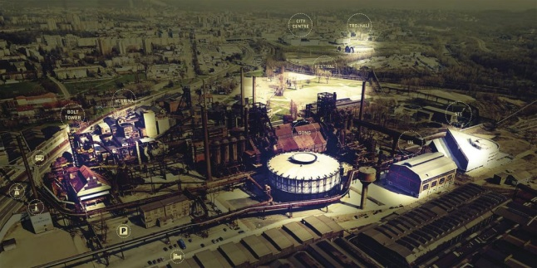
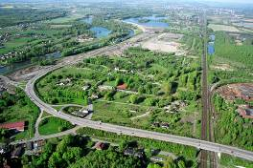
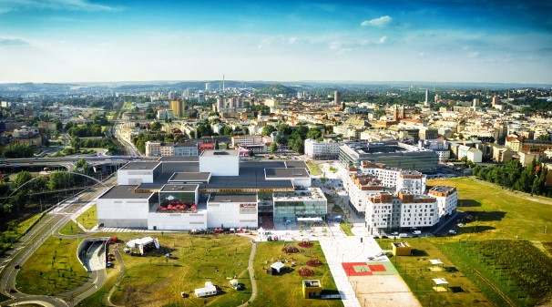
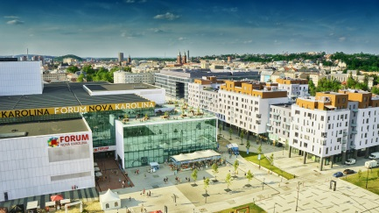
Brownfields
One of the highest concentrations of brownfields in the Czech Republic
Approximately 8.9 % of the city area (19.04 km²)
Development potential
The two largest projects: New Karolina and the Vítkovice Area
The development area Ostrava-Hrušov: “social“ brownfield
The Vítkovice Area
Hrušov
New Karolina
www.ostrava.cz

Slide 30
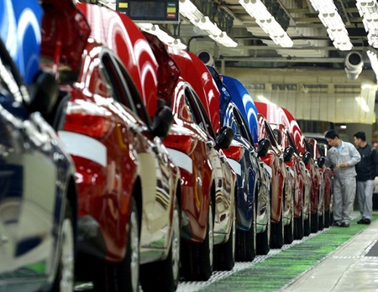
An automotive region on the move
Producing more than 3,190 cars a day
Hyundai, Kia, Fiat and Opel within a 100 km radius of Ostrava
27,796 automotive industry jobs in the Region
Subsupliers: Mobis, Plakor, Mahle Behr, Cromodora wheels, Varroc
Ostrava is 30 min far from Nošovice, site of the first European Hyundai factory
www.ostrava.cz

Slide 31

Incentives
Financial support: 200 000 CZK → per new job created
  Mošnov Strategic Industrial Zone – extra state support provided: up to 300 000 CZK per new job created
Financial support for employee training (up to 50 % of training costs)
Reduced rate of corporate income tax (for a period of 10 years)
Exemption from real estate tax (for a period of 5 years)
City incentives:
Implementation of infrastructure requirements
Assistance in arranging building permits and licences
Developed and flexible transport system for production facilities operating in 3 shifts
Good availability of qualified workforce, including university-educated experts
Full support for meeting your company’s requirements
Communicative state administration, keen to listen and support investors
www.ostrava.cz

Slide 32
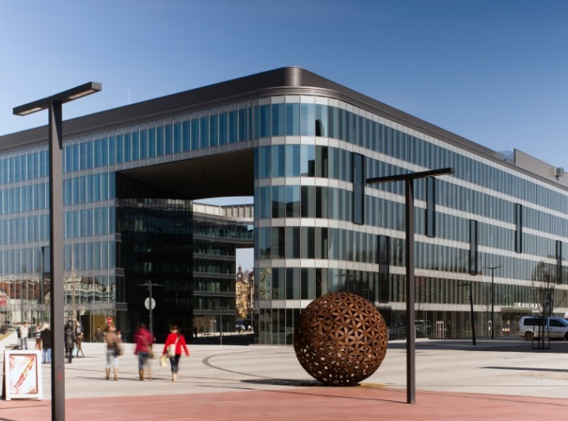
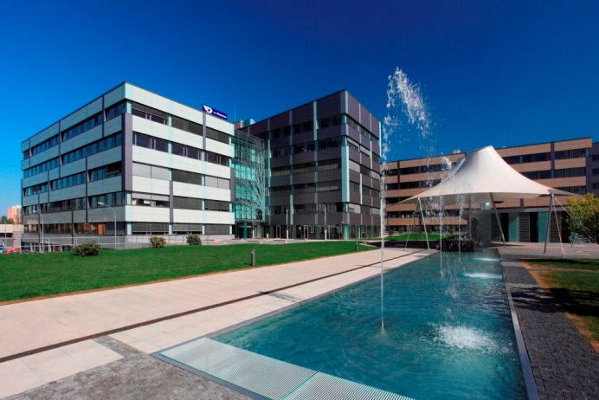
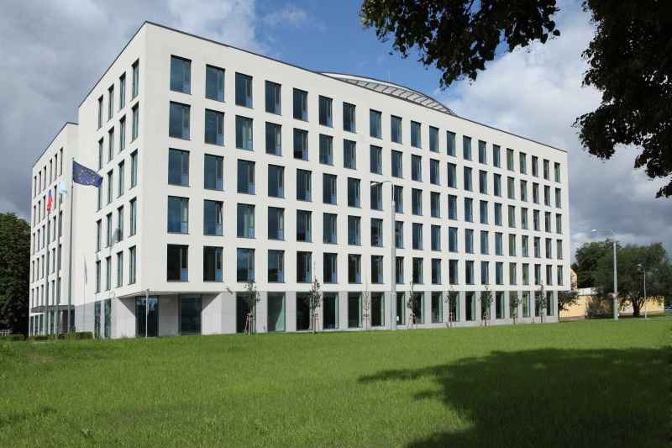
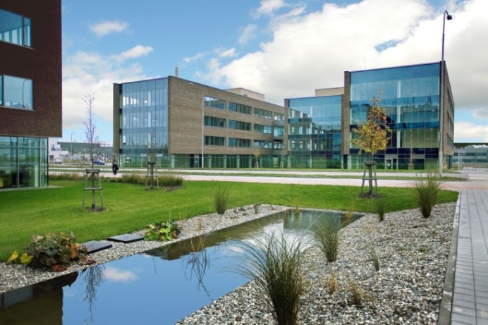
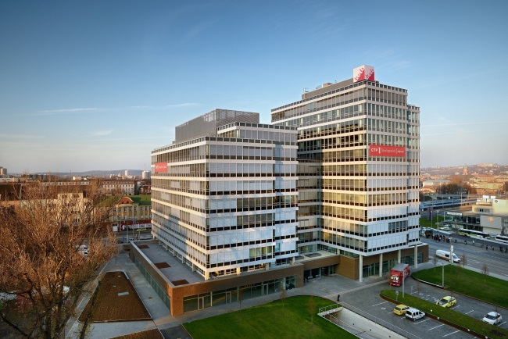
A-class office spaces
The Orchard (Red Group)
Nordica (Skanska)
Nová Karolina Park (Passerinvest Group)
IQ Office Park (CTP)
AXIS Office Centre (CTP)
Overall area in Ostrava: 214,900 m² (H1/2017), Vacancy rate 17.6 %
Source: JLL, 2017

Slide 33
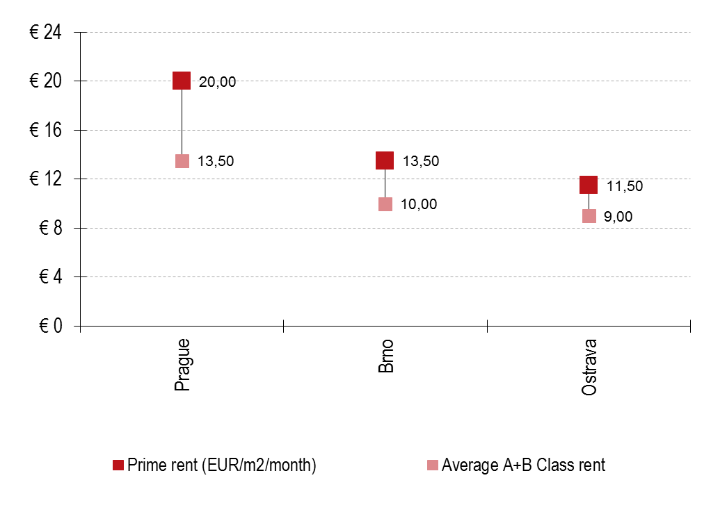
Office spaces
comparison of rents/month (H3/2017)
Prime rent in offices „A“ is maximum 11,5 € / month / m²
Average rent in offices A and B in Ostrava is from 7-9 € / month / m²
214 900 m² Stock
4 500 m² under construction
17,6% vacancy rate
Source: JLL 2017
www.ostrava.cz

Slide 34
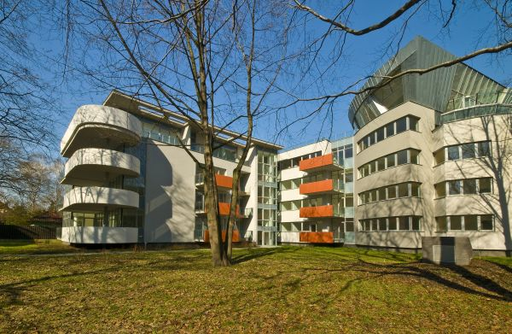





Housing
Améba
Nová Karolina
Ostravská brána
Podkova
„…and others under development“
www.ostrava.cz

Slide 35

Housing – development of average flats prices in Ostrava (EUR)
Source: www.realitycechy.cz
www.ostrava.cz

Slide 36

Housing – average flats prices of the size of 3+1 (EUR)
Source: www.realitycechy.cz
www.ostrava.cz

Slide 37





Hotels
Hotel CLARION CONGRESS HOTEL OSTRAVA****
rekonstrukce dokončena 2013
Hotel Park Inn Ostrava ****
dokončen 2008
In Ostrava there are 65 collective accommodation facilities (5,228 beds)
Hotel Mercure Ostrava ****
dokončen 2011
www.ostrava.cz

Slide 38



GONG conference and concert hall
For 1500 participants
WHO conference
SHELL conference
NetDirect /SHOPEXPO The largest e-commerce conference in Central Europe
SILVER B.C. / Shell Retailers Conference
Finclub plus a.s. international conference
TEDx conference GALÉN - SYMPOSION s.r.o. medical congress
LESTO s.r.o. - 9th RE/MAX CONVENTION 2015
Jagello 2000 Galla Dinner Nato Days
OMNIS OLOMOUC professional electronics exhibition ELFETEX
www.convention.ostrava.cz

Slide 39




Retail
Futurum
Avion Shopping Park
Forum Nová Karolina

Slide 40



Logistic parks
Tulipan Park Ostrava
Logistic Park Ostrava
CTPark Ostrava
Multimodal logistic centre Mošnov
Overall Area in Ostrava: 476,700 m² in H1/2017
Source: JLL

Slide 41

Industrial property
Overall rentable area in Ostrava: 76,700 m²
The vacancy rate: 2,34 %
comparison of rents/month (H1/2017):
Source: JLL, 2017

Slide 42






Science, Research, Innovation
CAIT - the Centre for Advanced and Innovative Technologies
VŠB – Technical University of Ostrava Business Incubator
Technology Centre for Energetics
Moravian-Silesian Innovation Centre
www.ostrava.cz
Notes:
Ostrava s 300 tisíci obyvatel se proto má časem proměnit z centra těžkého průmyslu na město moderních technologií
Superpočítač Salomon je dle žebříčku TOP 500 oficiálně 40. nejvýkonnějším superpočítačem na světě. Spolu s počítačem Anselm patří do projektu Centrum excelence IT4Innovations, které v České republice představuje největší koncentraci výzkumného potenciálu v oblasti informatiky a výpočetní matematiky.

Slide 43


Science, Research, Innovation
Moravian-Silesian Innovation Centre
The MSIC works closely with its partners to create and implement projects, services, collaborative networks and other activities with the aim of improving the environment for enterprise and innovation in the Moravian-Silesian Region.
Located at the campus of the VŠB-Technical University of Ostrava
Current area of the park: 10 ha
Enables commercial activities to be interlinked with scientific research facilities, with a strong focus on technology transfer
Land for lease (PIANO, TANDEM, VIVA, TRIDENT multi-purpose buildings)
Companies at site: INGETEAM, HELLA AUTOTECHNIK, ELCOM, Invent Medical Group, CGI …
→ 58 companies in total
www.ms-ic.cz/en

Slide 44

Science, Research, Innovation
National Centre of Excellence for IT Research
The project includes the acquisition of a supercomputer.
The large cluster of the supercomputer was launched in operation in 2015 as the 40th most powerful supercomputer in the world with the power of 94,000 average laptops.
Run by the VŠB-Technical University of Ostrava – in conjunction with the University of Ostrava, the Silesian University and the Institute of Geonics.
The supercomputer centre will bring a wide range of benefits, enabling researchers to carry out extensive research calculations and increasing the competitiveness of institutions and companies using this state-of-the-art infrastructure.
www.it4i.cz

Slide 45





















International companies in Ostrava
… and many others

Slide 46
















Banks in Ostrava and surroundings
www.ostrava.cz

Slide 47

THINK SMARTER. THINK BIGGER. THINK DIFFERENT. THINK OSTRAVA.

Slide 48


Slide 49

www.conventionostrava.cz

