Slide 1
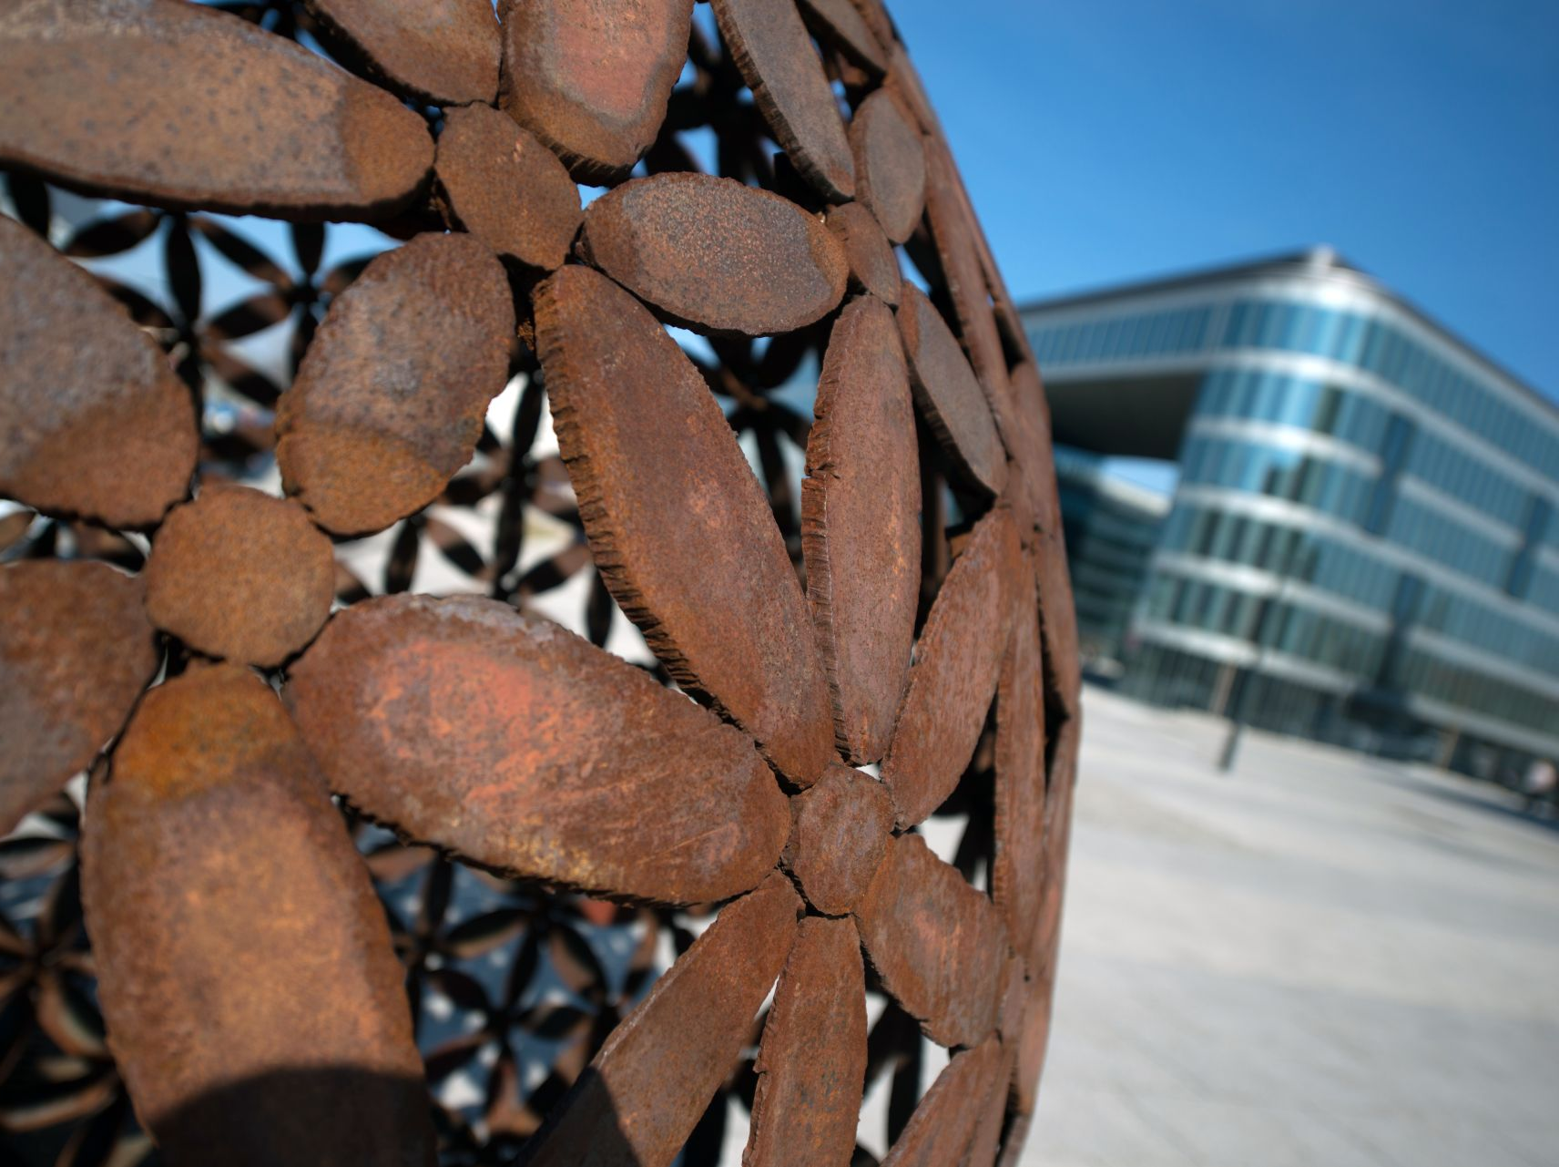

The Centre of the Fastest Growing Region of the Czech Republic
www.ostrava.cz

Slide 2
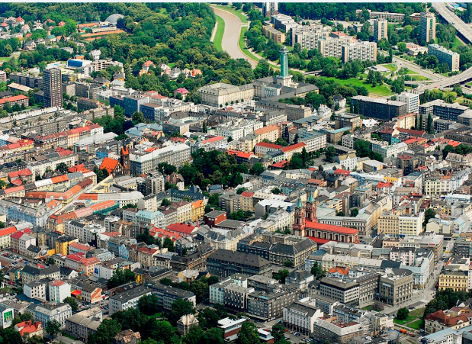
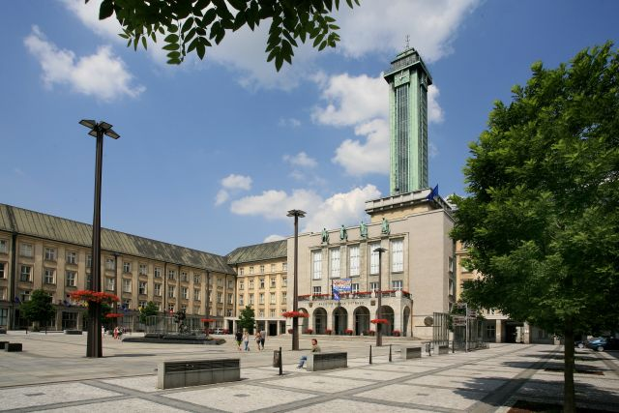
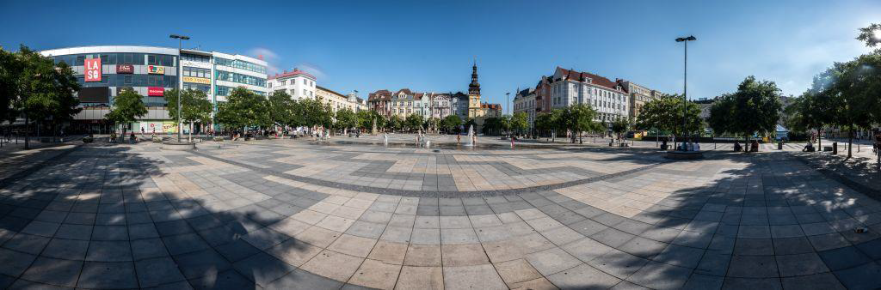
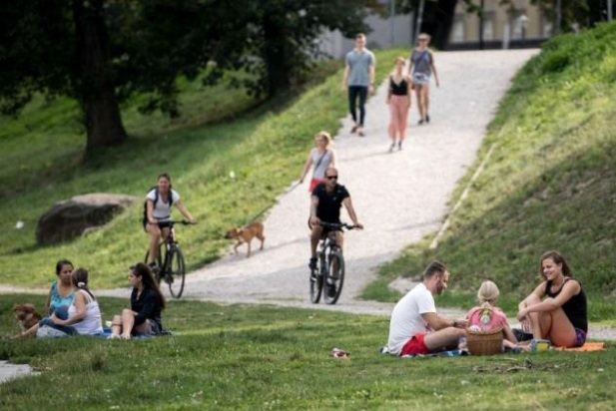

City of Ostrava
3rd largest city in the Czech Republic
Metropolis of the Moravian-Silesian Region
Area: 214 km²
299,483 inhabitants (1. 1. 2018)
Strategic location between Poland (15 km to the border) and Slovakia (50 km to the border)
International Airport 25 km from the city centre
D1 highway and railway corridor
www.ostrava.cz

Slide 3
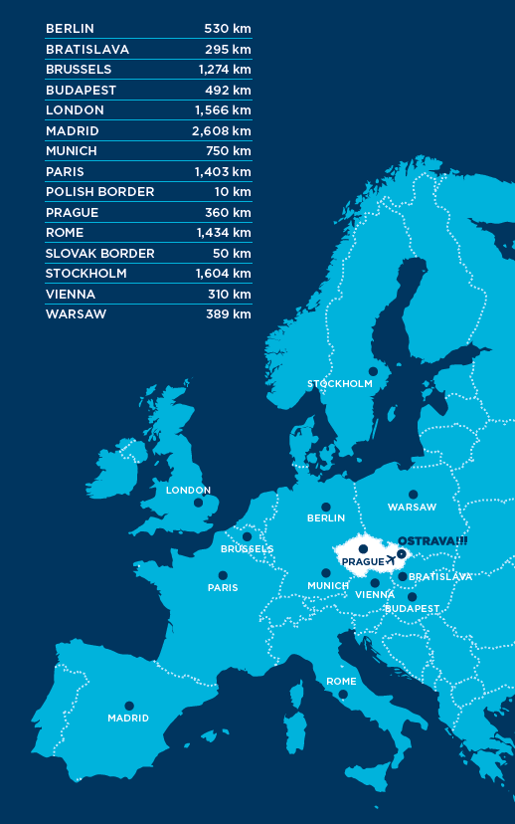
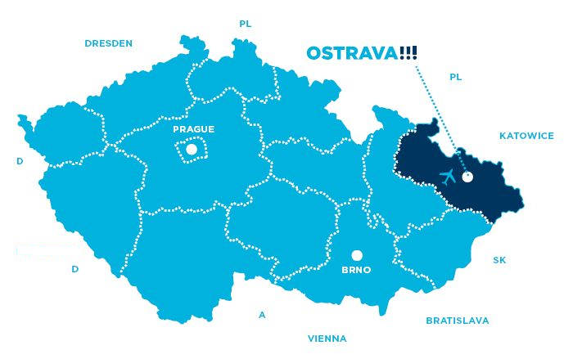
Location of the City
www.ostrava.cz

Slide 4
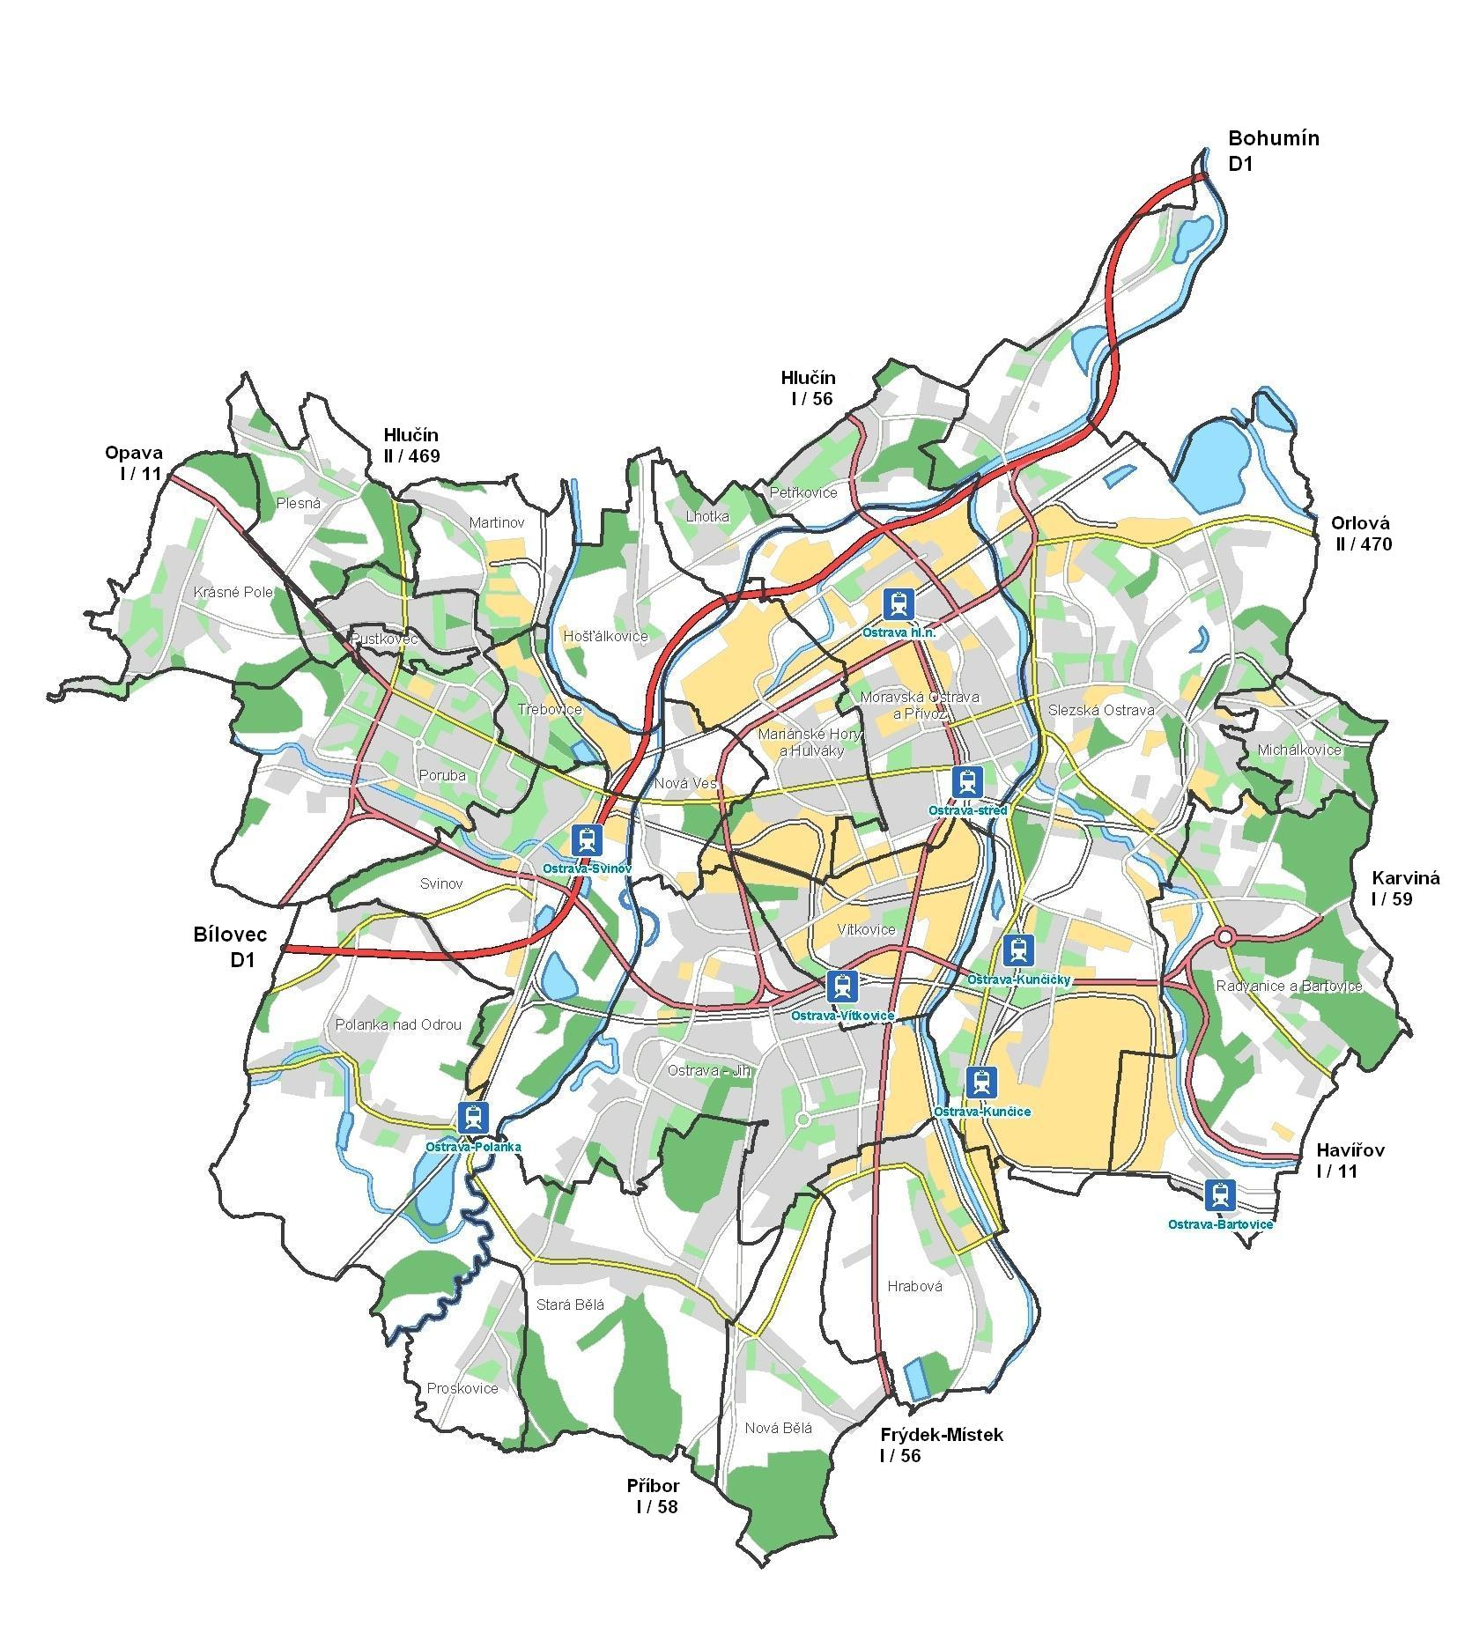
City Map
Poland
15 km
Prague
Slovakia
380 km
50 km
  Area: 214 km²
www.ostrava.cz

Slide 5
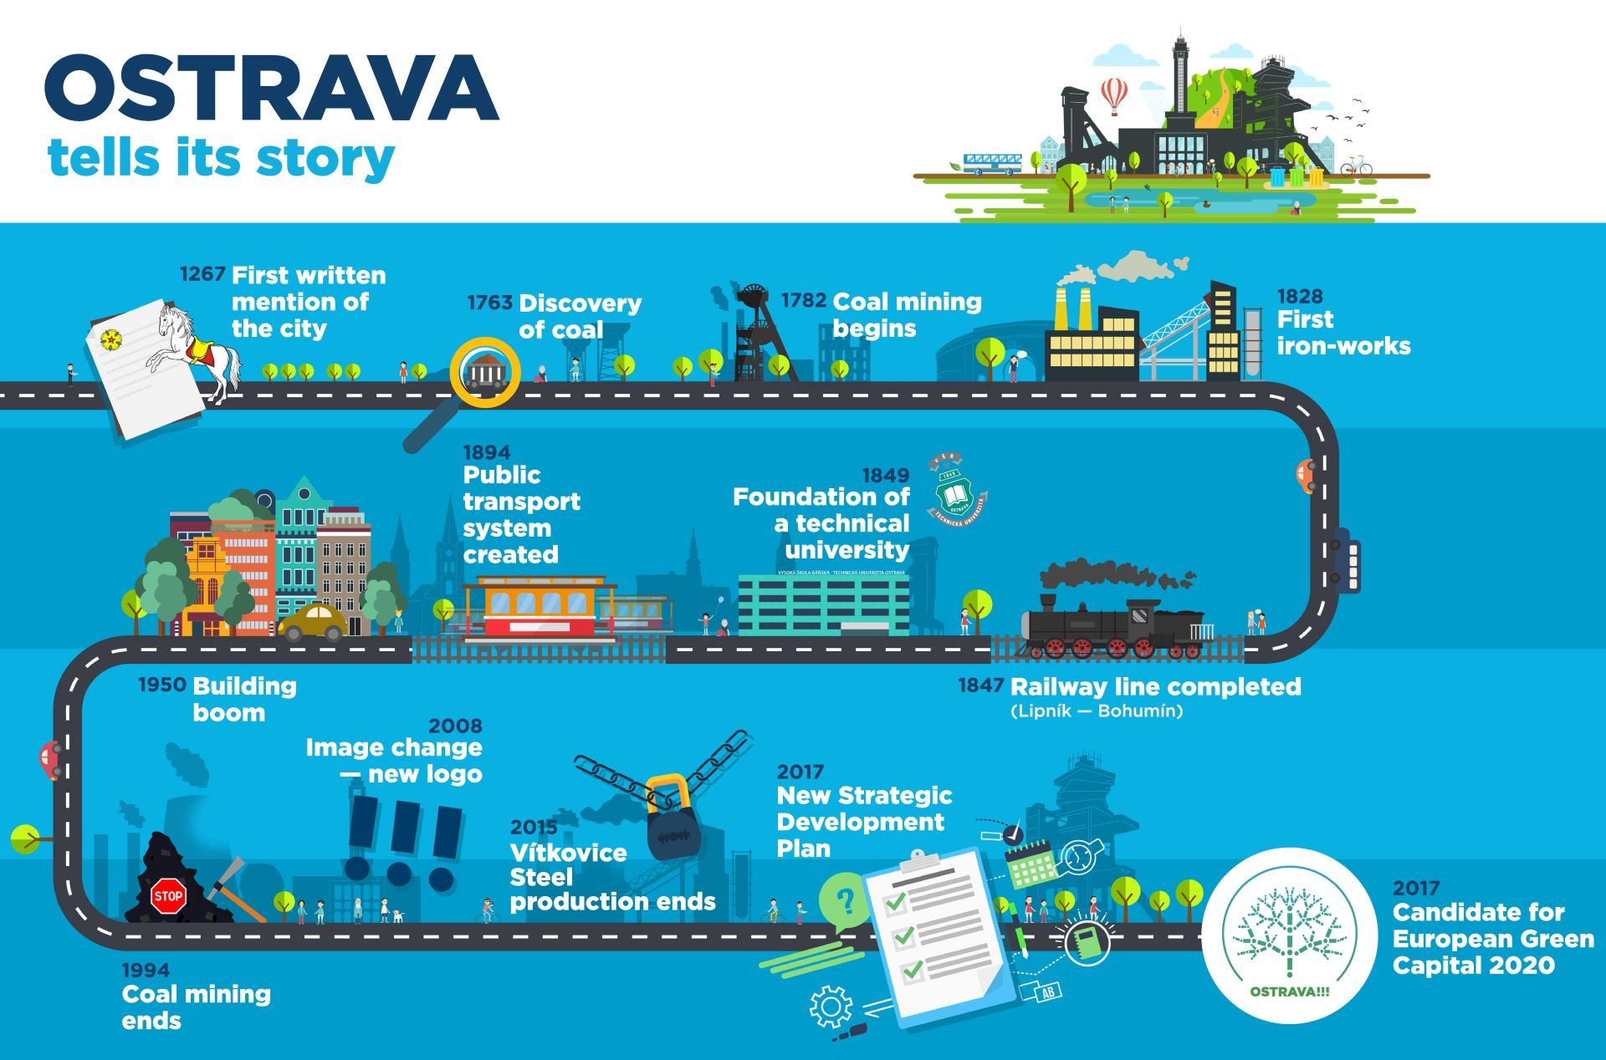
Notes:
Local business structure has changed dramatically since the onset of freemarket economy some 20 years ago
Industrial production relying solely on heavy industries has been phased out
Ostrava and its surroundings have seen a tremendous economic boom with investment pouring into industrial parks, development projects and new hotels
Many leading-edge high-tech companies have established themselves in the region producing high-tech products
Foreign-owned companies with a local production base are developing research and development facilities locally
Ve třetím největším českém městě dlouhé roky zavírá provoz jeden průmyslový podnik za druhým. Naposledy to byla před půl rokem ocelárna Vítkovice Steel. Ostrava s 300 tisíci obyvatel se proto má časem proměnit z centra těžkého průmyslu na město moderních technologií

Slide 6
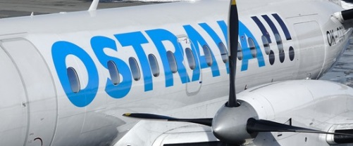

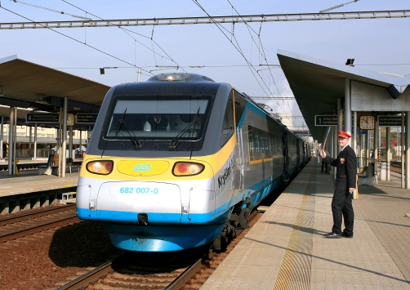
Transport
The Czech Republic’s north-eastern hub for transportation and logistics
Leoš Janáček Ostrava International Airport (25 km from the city centre)
  The largest regional airport in the Czech Republic
  The country´s second longest runway (3,500 x 63m)
  Regular travel links to Prague, London, Milan, Dubai and many charter flights
The D1 highway
  part of TEN’s Multiple Mode Corridor No. VI,
  a north-south link from the Czech-Polish border, through Ostrava to the D1 highway to Brno
  the D1 highway is joined up with the Polish A1 motorway through Katowice – Gdaňsk and on to Helsinki
Important railway hub for both regional and international trains
  national Corridor II line (the basis of one of the most important north-south railway links in the EU)
www.ostrava.cz

Slide 7

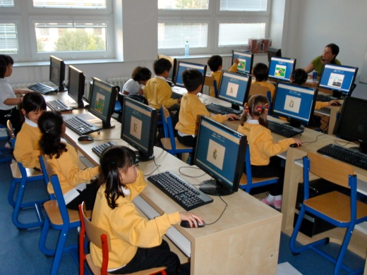
Universities and schools
Universities in Moravian-Silesian Region
  VŠB – Technical University of Ostrava (13 482 students)
  University of Ostrava (8 857students)
  College of Business and Law (1 372 students)
  University of Silesia, Opava (4 819 students)
  College of Social and Administrative Affairs, Havířov (250 students)
139 secondary school inc. music school in the region
  9 254 school leavers in the region in 2017
  of which 3 014 school leavers in Ostrava
8 bilingual schools and schools with an international approach
  The 1st International School of Ostrava and The Ostrava International School: education in English from 4 to 19, accredited in International Baccalauréate Diploma Programme
www.ostrava.cz

Slide 8
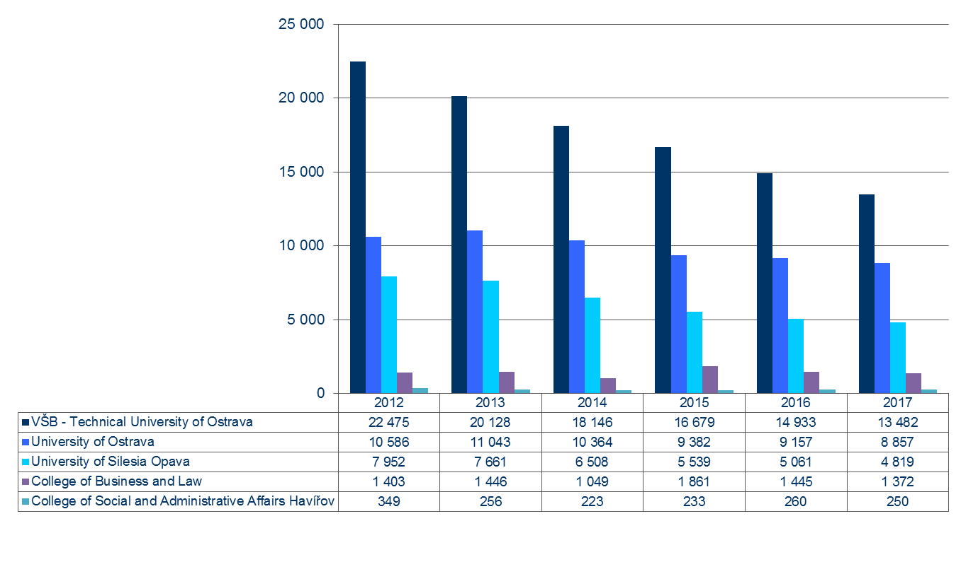
University student numbers - region
www.ostrava.cz

Slide 9
VŠB-Technical University of Ostrava
University of Ostrava
Source: Universities as of December 2017

Slide 10
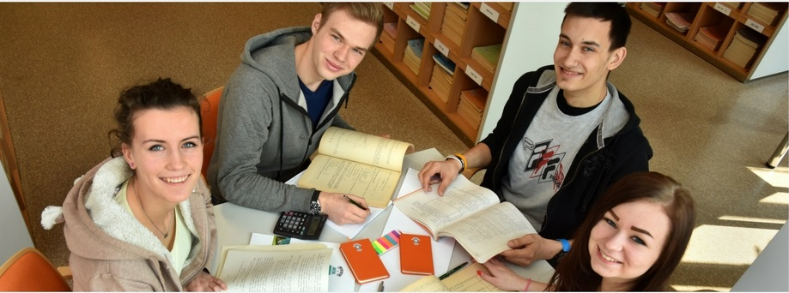
Secondary education – school leavers
Source: The Ministry of Education, Youth and Sports, 2018
www.ostrava.cz

Slide 11

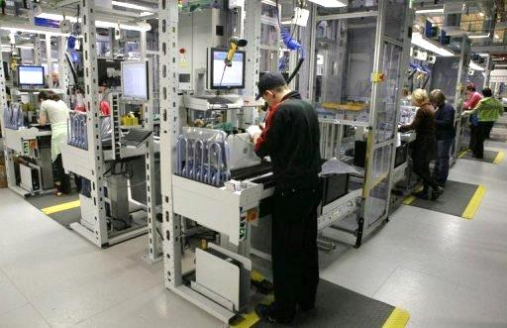
Work force
The Moravian-Silesian Region is the Czech Republic’s largest by population, with over 1.2 million inhabitants, and with the highest rate of unemployment
Qualified, experienced and skilled work force (industrial history)
Rate of unemployment (VIII/2018)
  5.8 % in Ostrava
  4.7 % in Moravian-Silesian Region
  3.1 % in the Czech Republic
23,711 students at 3 universities in Ostrava
13,500 students at the Technical University Ostrava
www.ostrava.cz
Notes:
Prestižní britský žebříček Times Higher Education před pár dny znovu zveřejnil seznam 200 nejlepších univerzit v Evropě. Jako jediná z České republiky se na 170. místě objevila Vysoká škola báňská Technická univerzita Ostrava. Technická univerzita Ostrava se už podruhé umístila nejlépe ze všech českých univerzit v prestižním světovém žebříčku Times Higher Education.

Slide 12
Workforce costs
Source: Trexima Ltd., Ministry of labour and social affairs
Minimum wage in the Czech Republic in 2018:
for a 40-hour week = CZK 12,200 per month = EUR 472.14
Basic rate per hour: CZK 73,20 = EUR 2.83
(1 EUR = 25.84 CZK as average e.r. July 2018)
www.ostrava.cz

Slide 13

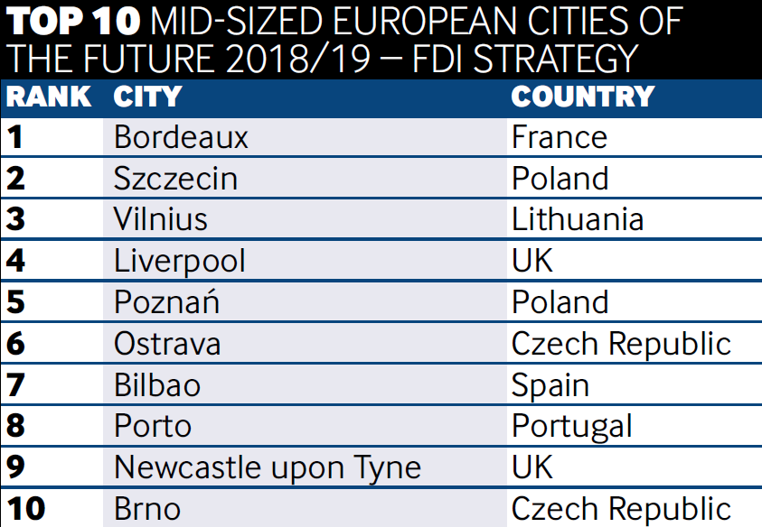
Ostrava ranks among the TOP 10 most attractive cities in Europe for investment
1st place „City of Business in the Czech Republic - 2017“
Excellent result in the prestigious British fDi Magazine survey (part of the Financial Times Group):
European Cities and Regions of the Future 2018/2019
Ostrava is the ideal strategic location helping you to grow your business.
www.ostrava.cz

Slide 14
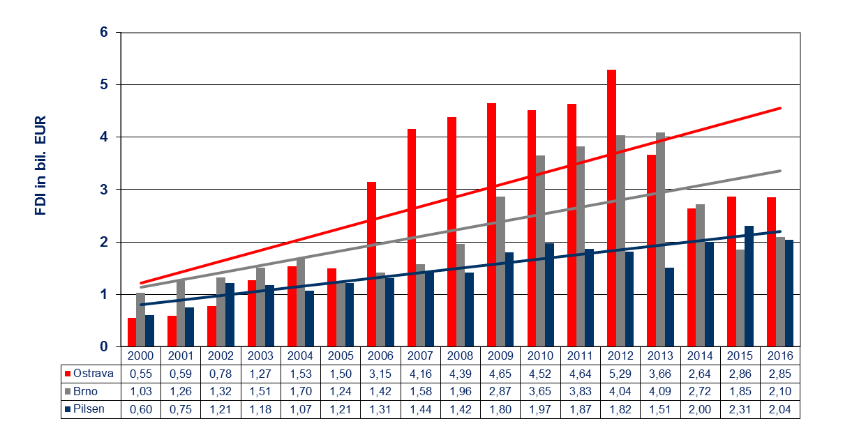
Foreign direct investments in bil. EUR (cumulative)
Dates as of 31 December, absolute values
Source: Czech National Bank 2018
www.ostrava.cz

Slide 15
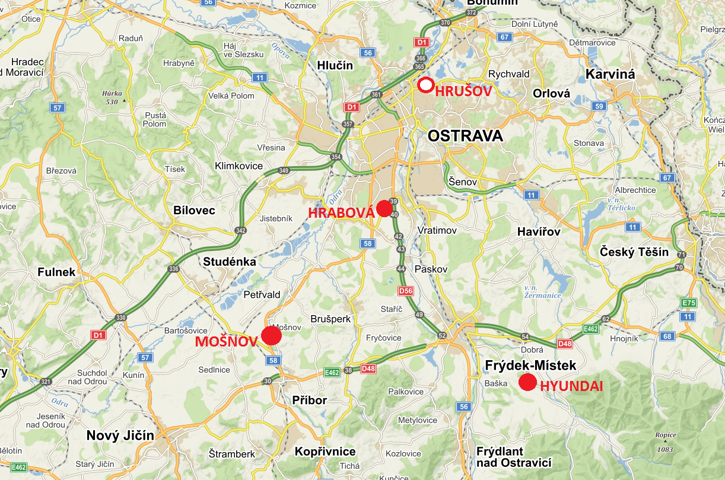
Industrial Zones

Slide 16
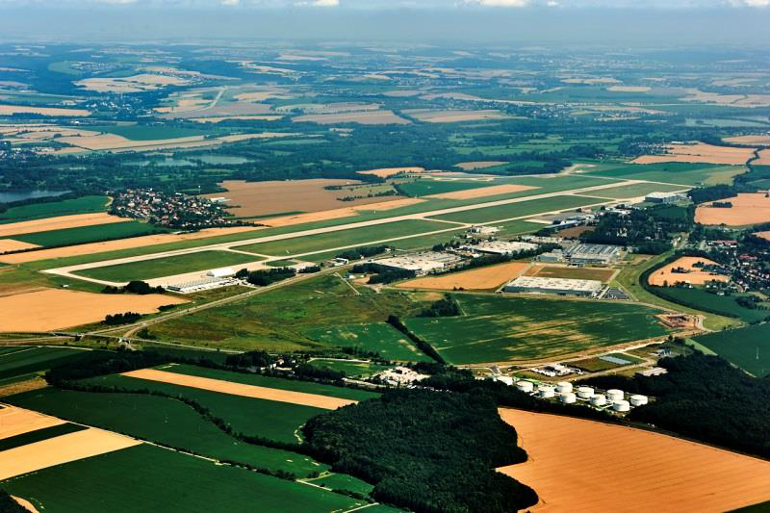
Industrial Zone Mošnov
Strategic Industrial Zone: 200 ha
- Multi-modal Logistics Centre (30+50 ha): 80 ha
Small Development zone: 32 ha
Small and Medium sized Enterprises (SME): 10 ha
Administrative Centre LJ: 20 ha
Facts:
2004: The original 30 ha zone is expanded to 130 ha
November 2005: Government resolution no. 1471 – the zone gains ‘strategic’ status and is further expanded to 200 ha
Companies have invested CZK 12.882 billion (as of 30 June 2018)
3 963 jobs created (as of 30 June 2018)
Area for sale to investors is currently 59 ha + 32 ha in Small Development zone
www.ostrava.cz

Slide 17
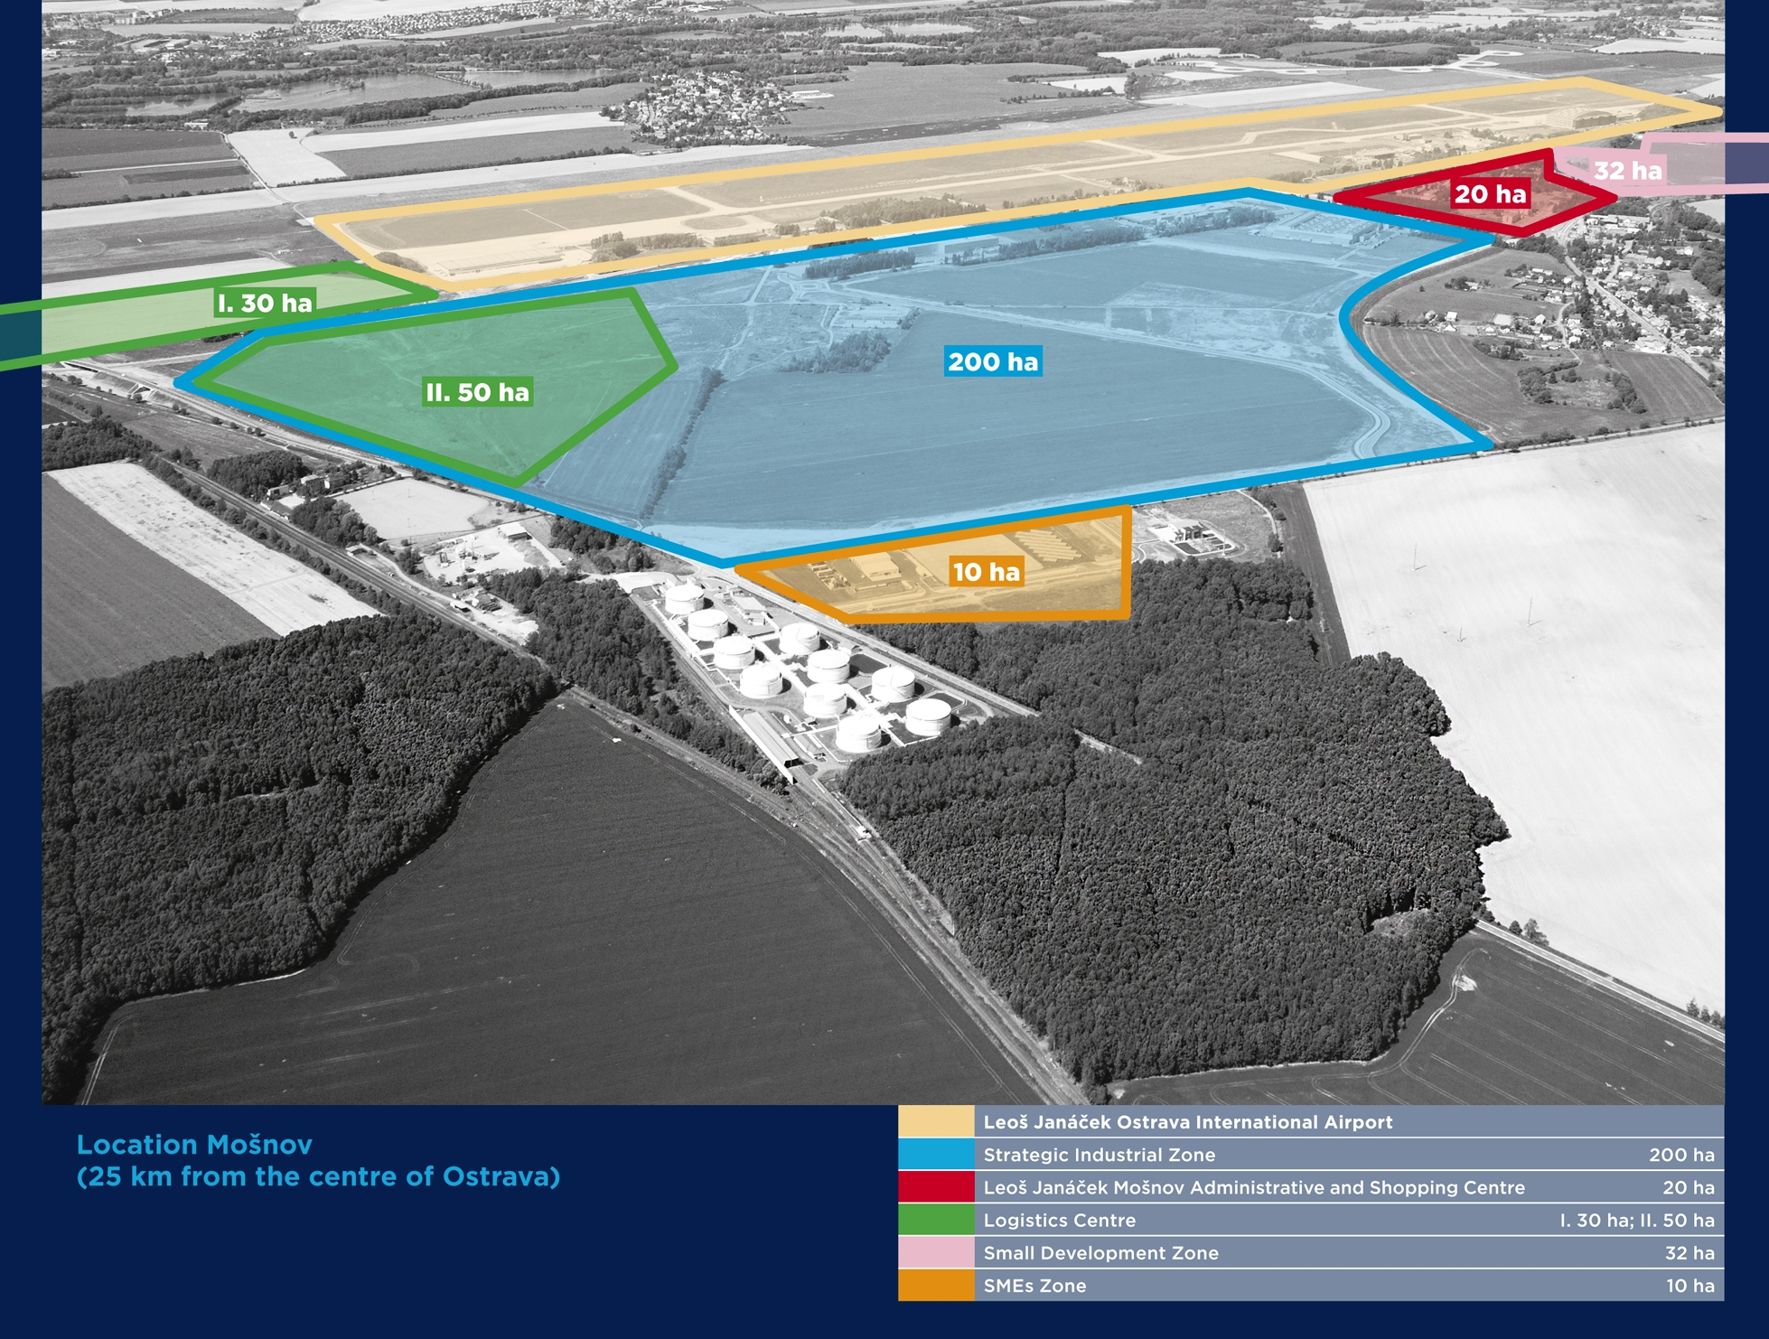

Slide 18
Investors in the Zone Mošnov – overview
 | Investment by companies as of 30 June 2018 (in mil. of CZK) | Number of jobs – June 2017 | Number of jobs – June 2018
MAHLE Behr Ostrava s.r.o. | 3 228 | 1 387 | 1 475
PLAKOR CZECH s.r.o. | 3 256 | 1 121 | 1 112
CROMODORA WHEELS s.r.o. | 2 723 | 400 | 474
ENES Cargo a.s. | 25 | 8 | 9
Ostrava Airport Multimodal Park s.r.o. | 135 | 0 | 2
Mobis Automotive System Czech s.r.o. | 3 481 | 285 | 887
Vítkovice-výzkum a vývoj-technické aplikace a.s. | 35 | 1 | 4
Total | 12 883 | 3 202 | 3 963
www.ostrava.cz

Slide 19
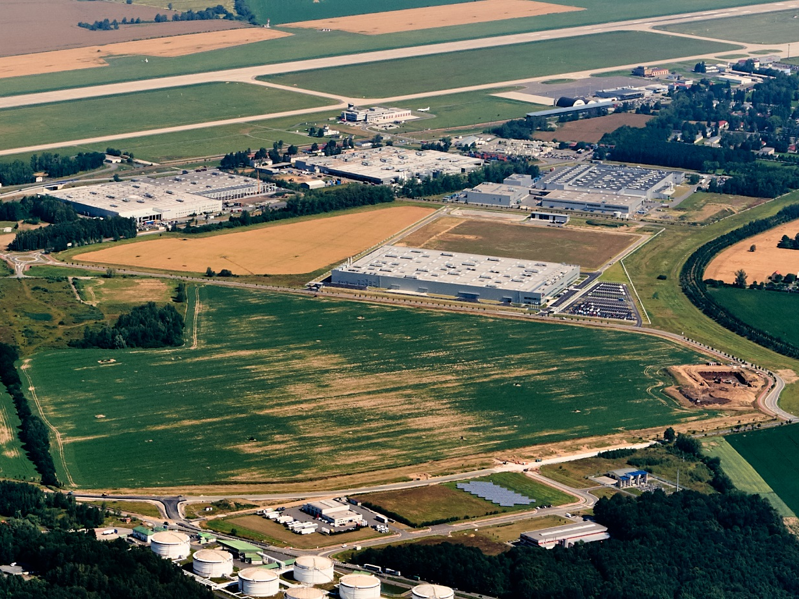




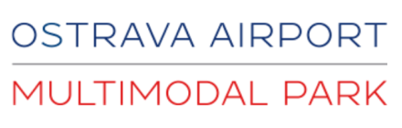

Slide 20
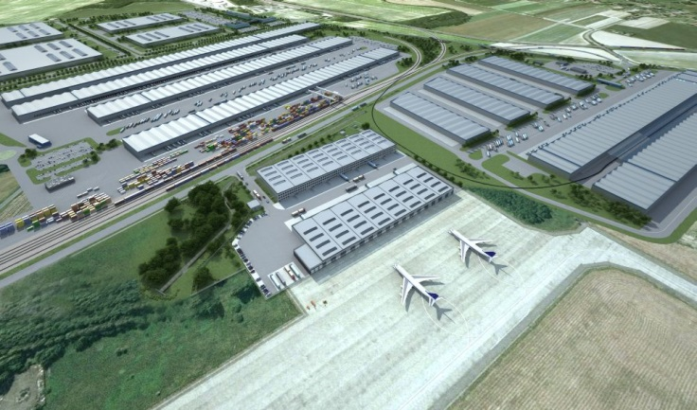
Multimodal logistics centre in the zone Mošnov
Logistics centre including container terminal – combination of road, rail
and air freight on one site – unique project within the Czech Republic
Developed in cooperation with the City of Ostrava and the Moravian-Silesian Region
Location: Ostrava- Mošnov Strategic Industrial Zone, 25 km from central
Ostrava, adjacent to Leoš Janáček Ostrava International Airport
Work begins: 4Q/2010
Completion of all phases: 2015 - 2023
Cost: CZK 4 billion
Total area: 80 ha
Phase 1: air freight centre completed / leased
Phase 2: rail freight centre work started 1/2018
Phase 3: multimodal cargo under preparation
www.ostrava.cz

Slide 21
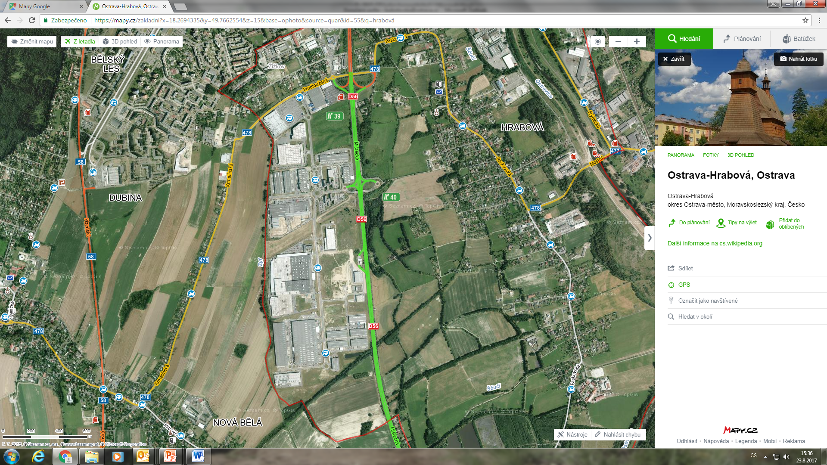
Hrabová Industrial Zone
15 ha
Industrial Zone: 115 ha
Commercial Zone: 15 ha
115 ha
Planning began in 1999 and continued in 2000-2007
The City originally prepared a site of 30+30 ha.
CTP Invest expanded the zone (total area now 115 ha)
Currently over 50 companies operate in the zone
Total investments in the zone have exceeded CZK 22.433 billion (as of 30 June 2018)
9 189 new jobs created (as of 30 June 2018)
The zone won the Ministry of Industry and Trade Award for Industrial Real Estate of the Year for 2004, 2005, 2007, 2009 and 2010 (1st and 2nd place for the City of Ostrava, twice 1st place for CTPark and 1st place for Brembo as an investor of the year 2010)
www.ostrava.cz

Slide 22
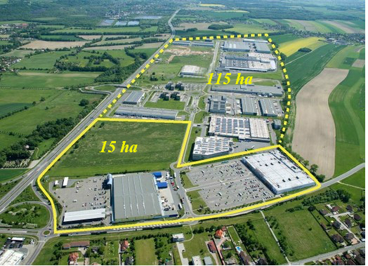
Hrabová Industrial Zone
Notes:
22

Slide 23
Investors in the Zone Hrabová – overview
 | Investment by companies as of 30 June 2018 (in mil. of CZK) | Number of jobs – June 2017 | Number of jobs – June 2018
PEGATRON CZECH s.r.o. | 1 117 | 987 | 1 509
SungWoo Hitech | 14 917 | 1 485 | 1 980
CTP Invest | 6 400 | 5 600 | 5 700
TOTAL | 22 434 | 8 072 | 9 189
www.ostrava.cz

Slide 24
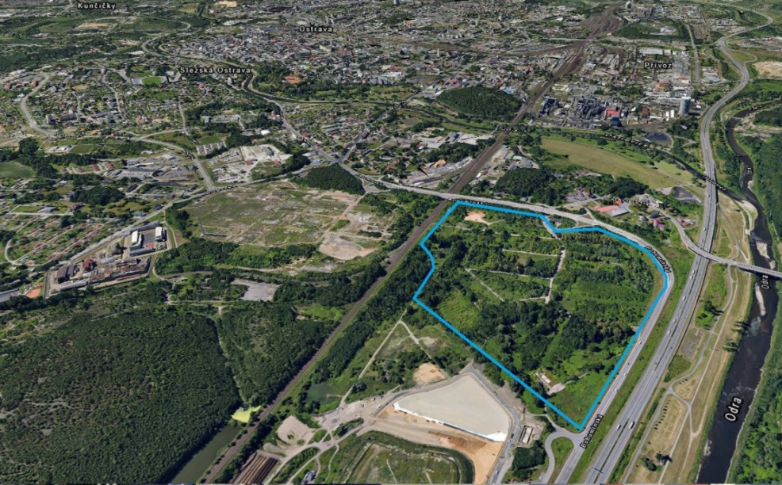
Hrušov Development Area
Size: 35 ha
Former settlement for workers
„Social Brownfield“
Non-outflow basin
Proximity of highway D1
Mining influence
No ecological damage
Hrušov represents a very important location, particularly suitable for small and medium-sized companies. Among the advantages of the Hrušov zone is an ideal transport connection, immediate vicinity to the D1 motorway and a railway line.
In September 2018, Ostrava's City Assembly approved the sale of the land to the investor Contera Management.
Besides technical infrastructure, the investor will also build light industrial units for warehousing and production, as well as "flexispace" facilities and units for technological development.

Slide 25
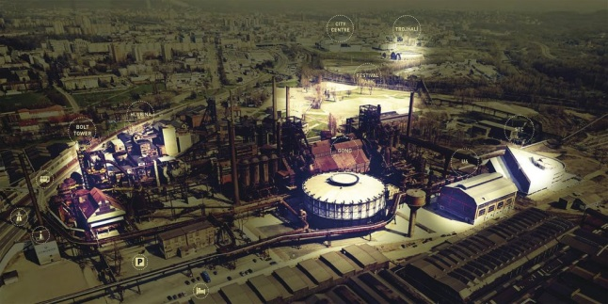
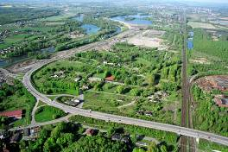
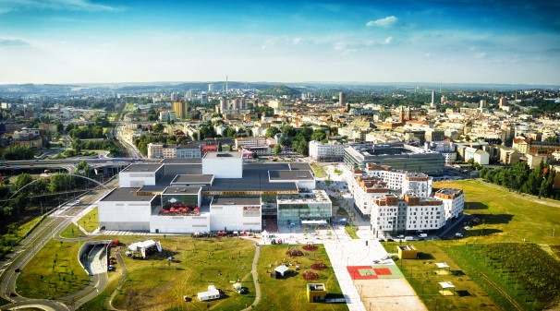
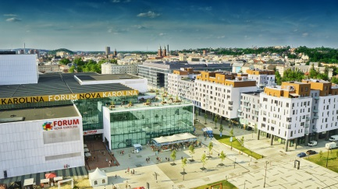
Brownfields
One of the highest concentrations of brownfields in the Czech Republic
Approximately 8.9 % of the city area (19.04 km²)
Development potential
The two largest projects: New Karolina and the Vítkovice Area
The development area Ostrava-Hrušov: “social“ brownfield
The Vítkovice Area
Hrušov
New Karolina
www.ostrava.cz

Slide 26

Incentives
Industrial Zone Mošnov:
Financial support:
  Mošnov Strategic Industrial Zone – extra state support provided: up to 300 000 CZK (€ 12 000) per new job created
Reduced rate of corporate income tax (for a period of 10 years)
City of Ostrava:
Financial support: 200 000 CZK → per new job created
Financial support for employee training (up to 50 % of training costs)
Reduced rate of corporate income tax (for a period of 10 years)
City incentives/advantages:
Full support for meeting your company’s requirements
Communicative state administration, keen to listen and support investors
Assistance in arranging building permits and licences
Implementation of infrastructure requirements
Developed and flexible transport system for production facilities operating in 3 shifts
Good availability of qualified workforce, including university-educated experts
www.ostrava.cz

Slide 27
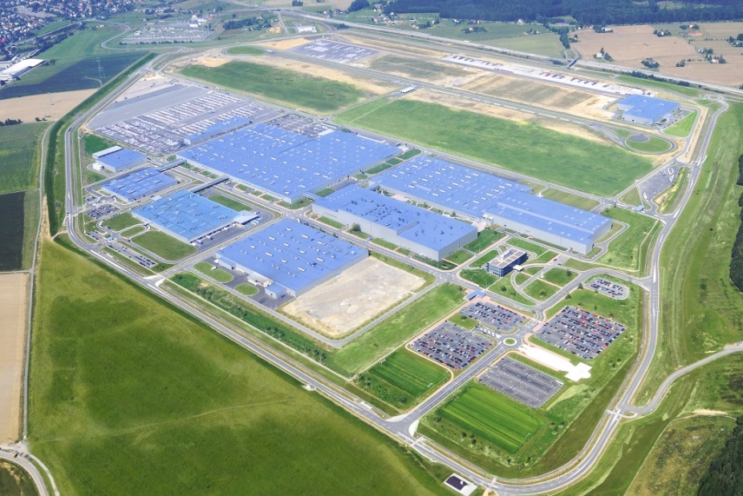

Strategic investor in the region
Hyundai Nošovice
30 km from Ostrava
Industrial zone: 200 ha
Total investment: 1.12 billion EUR
Strategic investor:
Hyundai Motor Manufacturing Czech
Established: 7. 7. 2006
The Hyundai investment is the largest industrial investment in the Moravian-Silesian Region since 1989, both in financial terms and in terms of new jobs created → major boost to the Region’s economic development.
Production capacity: 356,700 vehicles in 2017
Number of employees: 3,300 (2017)
www.ostrava.cz

Slide 28
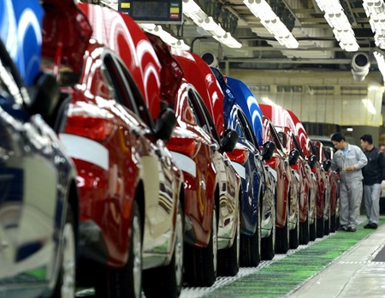
An automotive region on the move
Producing nearly 3 500 cars a day
Hyundai, Kia, Fiat, Opel and Tatra within a 100 km radius of Ostrava
30 675 automotive industry jobs in the Region
Subsuppliers: Mobis, Plakor, Mahle Behr, Cromodora wheels, Varroc
Ostrava is 30 min far from Nošovice, site of the first European Hyundai factory
www.ostrava.cz

Slide 29
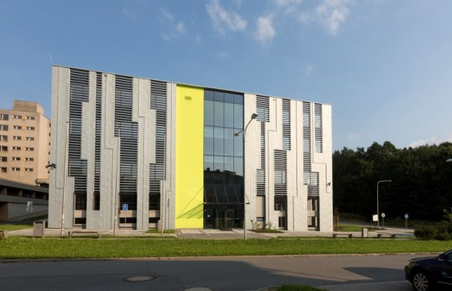
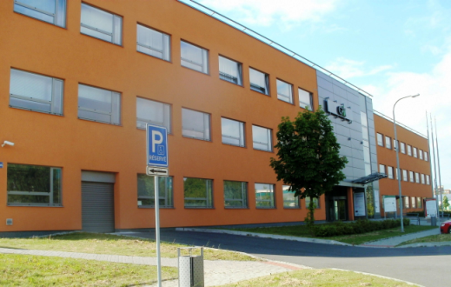

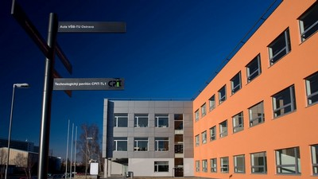
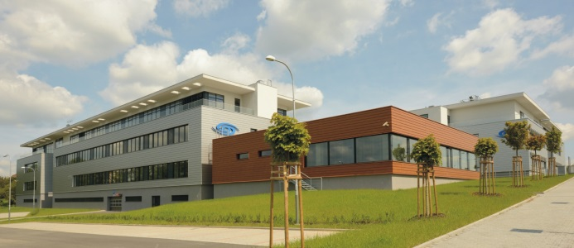
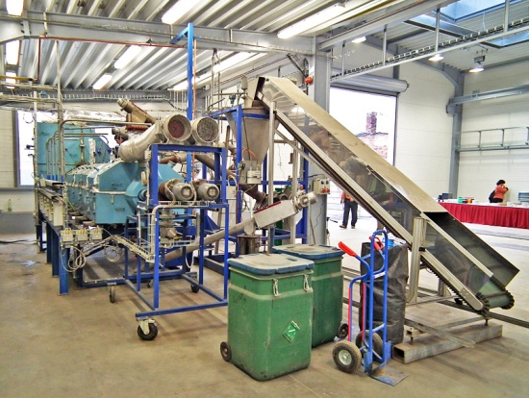
Science, Research, Innovation
CAIT - the Centre for Advanced and Innovative Technologies
VŠB – Technical University of Ostrava, Business Incubator
Technology Centre for Energetics
Moravian-Silesian Innovation Centre
www.ostrava.cz
Notes:
Ostrava s 300 tisíci obyvatel se proto má časem proměnit z centra těžkého průmyslu na město moderních technologií
Superpočítač Salomon je dle žebříčku TOP 500 oficiálně 40. nejvýkonnějším superpočítačem na světě. Spolu s počítačem Anselm patří do projektu Centrum excelence IT4Innovations, které v České republice představuje největší koncentraci výzkumného potenciálu v oblasti informatiky a výpočetní matematiky.

Slide 30
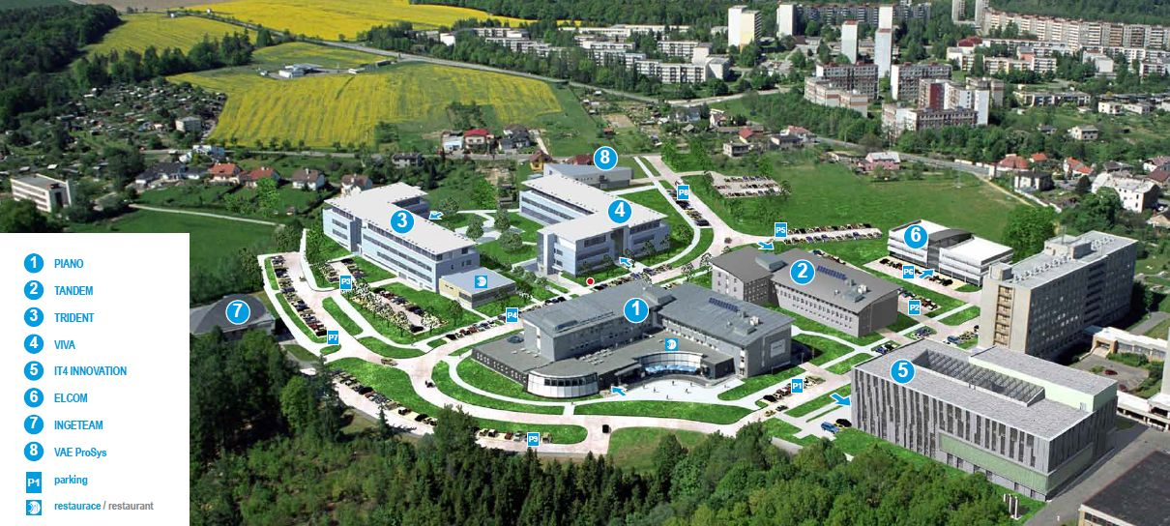
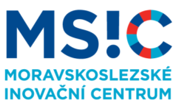
Science, Research, Innovation
Moravian-Silesian Innovation Centre
The MSIC works closely with its partners to create and implement projects, services, collaborative networks and other activities with the aim of improving the environment for enterprise and innovation in the Moravian-Silesian Region.
Located at the campus of the VŠB-Technical University of Ostrava
Current area of the park: 10 ha
Enables commercial activities to be interlinked with scientific research facilities, with a strong focus on technology transfer
Land for lease (PIANO, TANDEM, VIVA, TRIDENT multi-purpose buildings)
Companies at site: INGETEAM, HELLA AUTOTECHNIK, ELCOM, Invent Medical Group, CGI …
www.ms-ic.cz/en

Slide 31
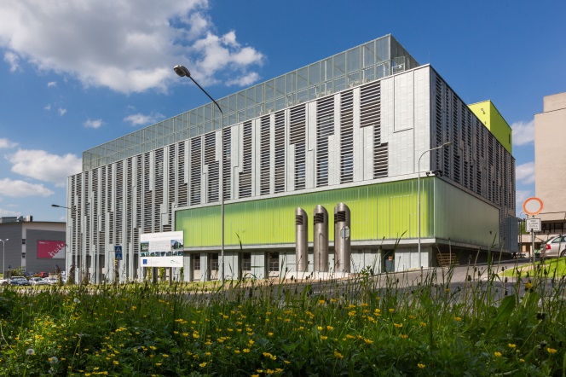
Science, Research, Innovation
National Centre of Excellence for IT Research
The project includes the acquisition of a supercomputer.
The large cluster of the supercomputer was launched in operation in 2015 as the 40th most powerful supercomputer in the world with the power of 94,000 average laptops.
Run by the VŠB-Technical University of Ostrava – in conjunction with the University of Ostrava, the Silesian University and the Institute of Geonics.
The supercomputer centre will bring a wide range of benefits, enabling researchers to carry out extensive research calculations and increasing the competitiveness of institutions and companies using this state-of-the-art infrastructure.
www.it4i.cz

Slide 32
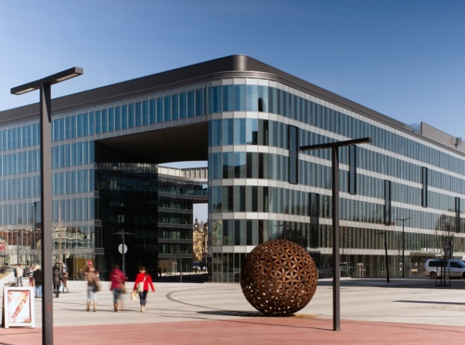
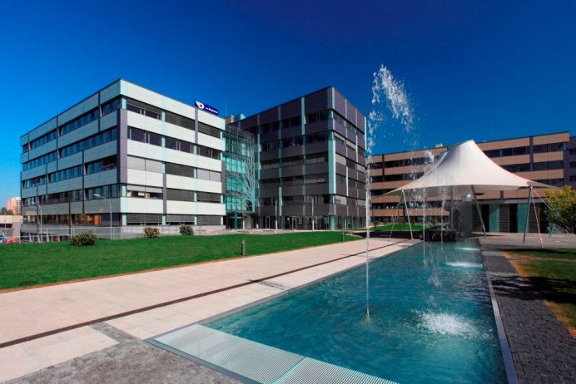
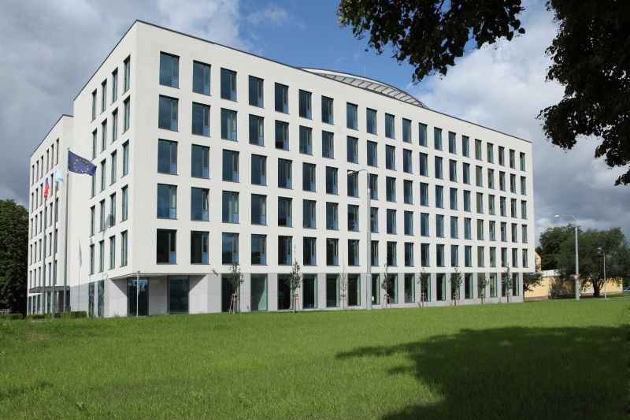
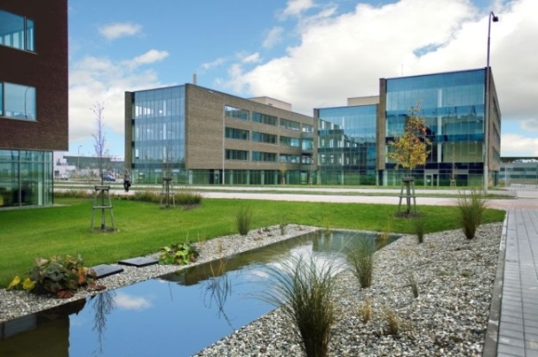
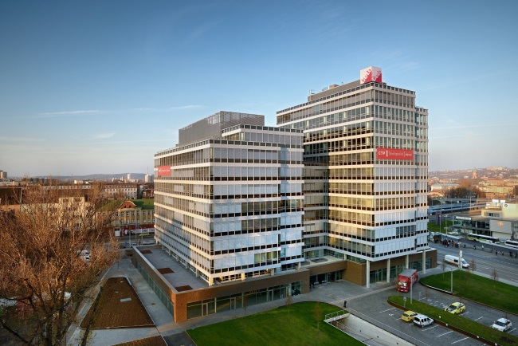
A-class office spaces
The Orchard (Hartenberg Holding)
Nordica (Skanska)
Nová Karolina Park (Passerinvest Group)
AXIS Office Centre (CTP)
IQ Office Park (CTP)
Overall area in Ostrava: 213 400 m², vacancy rate 13.3 % (December 2017).

Slide 33
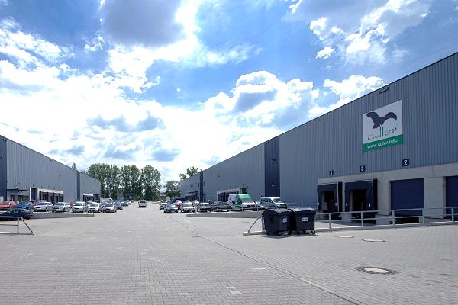
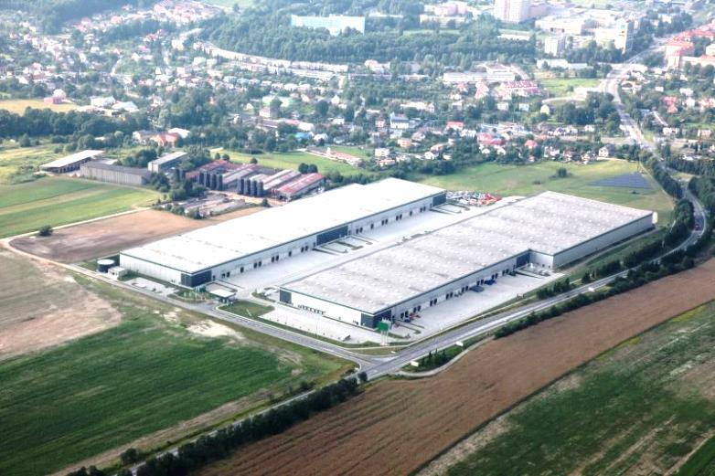
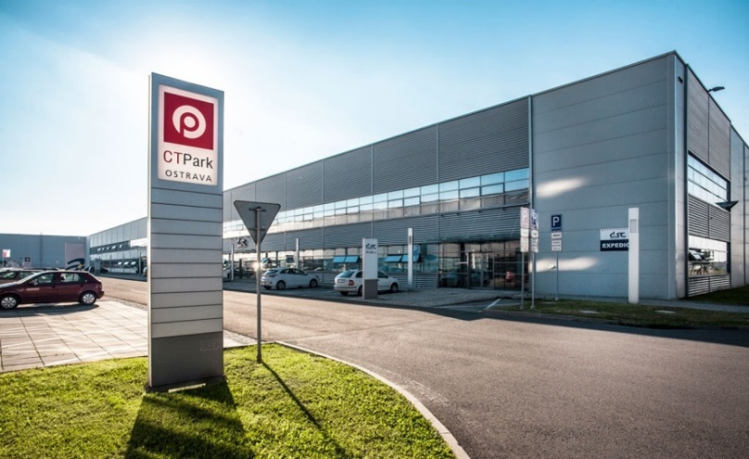
Logistic parks
Tulipan Park Ostrava
Logistic Park Ostrava
CTPark Ostrava
Multimodal logistic centre Mošnov
Overall area in Ostrava: nearly 500 000 m².

Slide 34
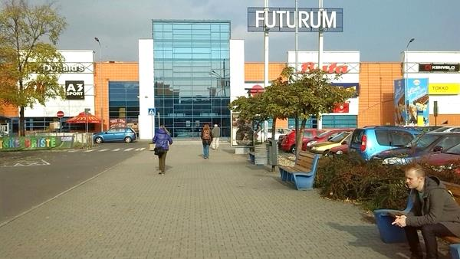
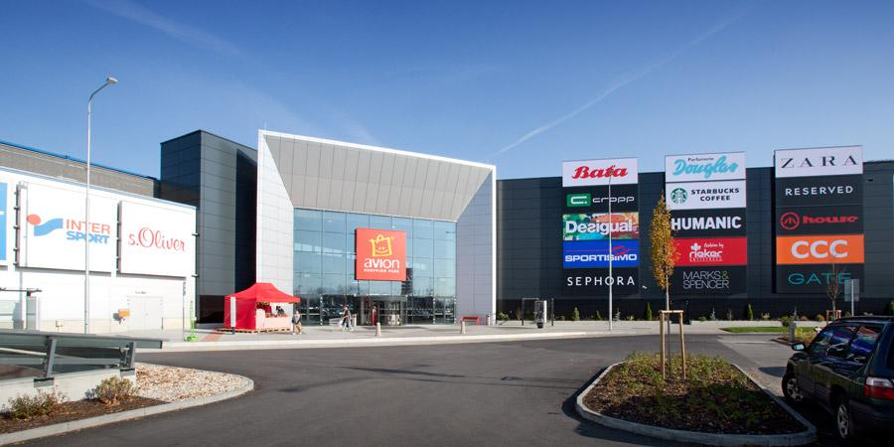



Retail
Avion Shopping Park
Futurum
Avion Shopping Park
Forum Nová Karolina
„…and others under development (e.g. Outlet Arena Moravia)“

Slide 35






Residential projects
Améba
Nová Karolina
Ostravská brána
Podkova
„…and others under development“
www.ostrava.cz

Slide 36





Hotels
Hotel CLARION CONGRESS HOTEL OSTRAVA****
Hotel Park Inn Ostrava ****
In Ostrava there are 64 collective accommodation facilities (5,324 beds)
Hotel Mercure Ostrava ****
www.ostrava.cz

Slide 37


Unique conference facilities
Ostrava’s rich industrial heritage has been beautifully preserved in a plethora of historic buildings, which now offer ideal venues for your events.
An amazing and unforgettable atmosphere is guaranteed!
Events of international importance:
  WHO – 6. Ministerial conference on Environment and Health, June 2017
  TBEX Europe Ostrava 2018, July 2018
  NetDirect /SHOPEXPO - the largest e-commerce conference in Central Europe
  Music festivals (Colours of Ostrava, Beats for love….)
  Sport events (Beach Volleyball World Tour 2018, June 2018)
Gong, Lower Vítkovice Area
Tripple Hall
www.convention.ostrava.cz

Slide 38




















International companies in Ostrava
… and many others

Slide 39

OSTRAVA: good place for living
www.ostrava.cz

Slide 40





OSTRAVA: good place for living
Golf courses
Wellness
Folk architecture
Rich cultural life
Beskydy mountains within a reach

Slide 41
Summary
  3rd largest city in the Czech Republic
  Metropolis of the region with more than 1,2 mil inhabitants
  Strategic location on the crossroad of 3 countries
  Investments in education
  8 bilingual schools and schools with an international approach
  Science, Research, Innovation Support
  Developed infrastructure
  Highly developed public transport system
  MOODY´s rating: A1 positive
  Ostrava ranks among the TOP 10 most attractive cities in Europe for investment
  Important international companies located in the city
  Leisure activities
www.ostrava.cz

